Slide 1
Would you rebel ?
An inquiry among high-risk youth in eastern DRC
Nik Stoop (University of Antwerp & KULeuven)
Marijke Verpoorten (University of Antwerp)

Slide 2
Motivation
Contribution
Method
Data
Results
Conclusion

Slide 3
Motivation

Slide 4
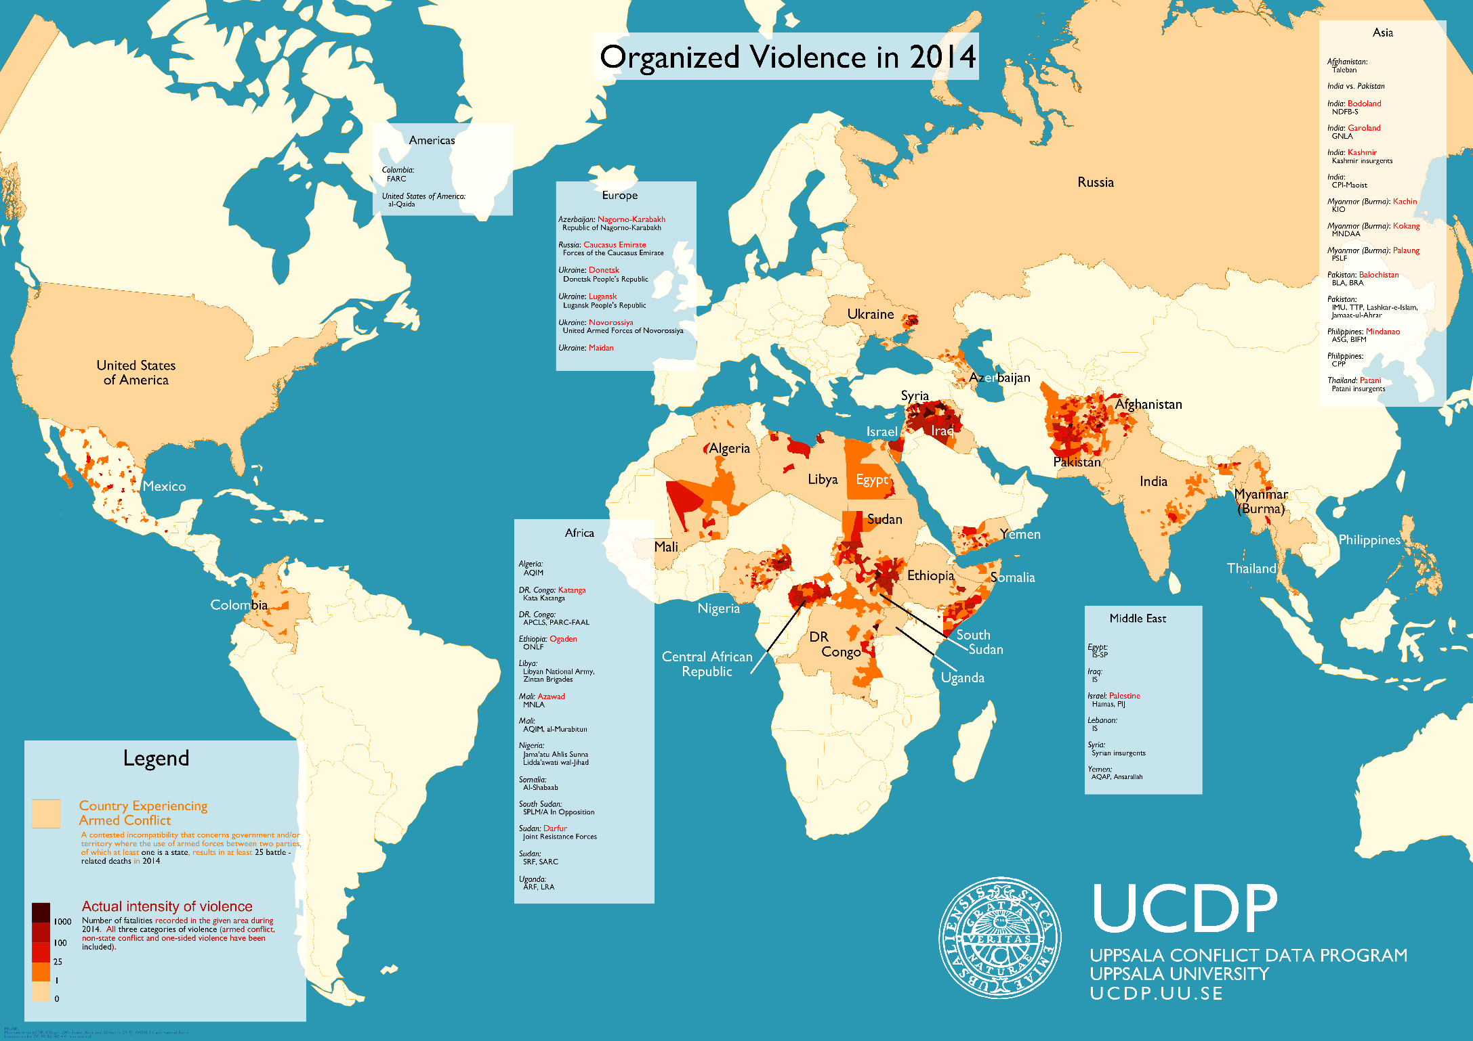
In 2014, there were 40 armed conflicts, of which 9 in SSA.
In the period 1995-2014, 28 SSA countries experienced armed conflict (of which 14 “civil war”, on average for a duration of 7 years)
(Pettersson & Wallensteen, 2015).
Notes:
Since 1995, 14 out of 49 SSA countries have experienced civil war, and another 14 SSA countries have experienced lower intensity civil conflict. (Pettersson & Wallensteen 2015)

Slide 5
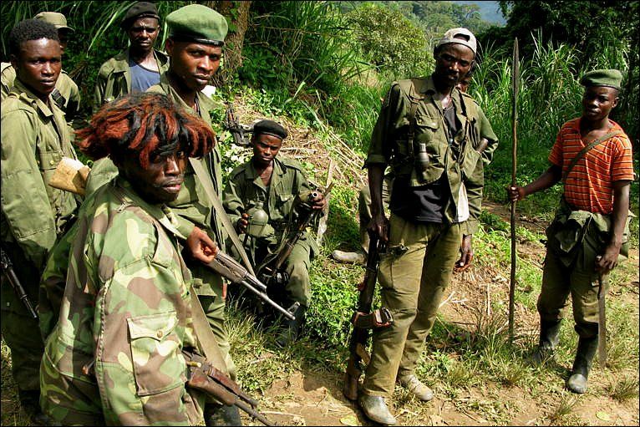

Slide 6
Theories on individual participation in violence, distinguish between two major types of selective incentives:
  Material : protection from harm, opportunities to loot, future rewards (e.g. Grossman 1999, Fearon 2007)
  Non-material : satisfaction in pursuing justice - for the group (cf. the role of identity and ideology), pleasure in agency, threats and punishments (cf. coercion) (Gurr 1971, Wood 2003)
Notes:
“economic factors”
“psychological or sociological factors”

Slide 7
Massive number of cross-country studies on causes of civil war
  Collier & Hoeffler 1998, Fearon & Laitin 2003, Miguel et al. 2004, Besley & Persson 2011, Bazzi & Blattman 2014, …
  These cross-country studies are not very useful to test theories of individual behavior (e.g. role of GDP ≠ role of individual-level poverty) and some aspects (e.g. grievances) are difficult to capture with country-level data.
→ To test theories about individual behavior we need individual-level data.
Notes:
Since 1995, 33 countries have experienced civil war
: are it the poorest who fight ?
(battle deaths >1000)
(25< battle-deaths < 1000)
on average for a duration of 7 years between 1995 and 2014

Slide 8
Contribution
Notes:
This paper asks a simple question “Would they Rebel ?”. We ask this question to artisanal miners in South-Kivu, DRC.

Slide 9
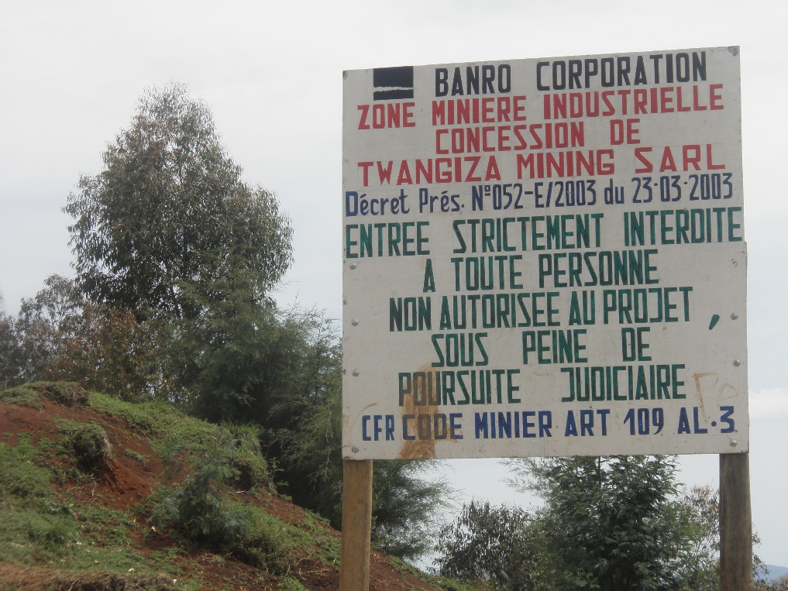
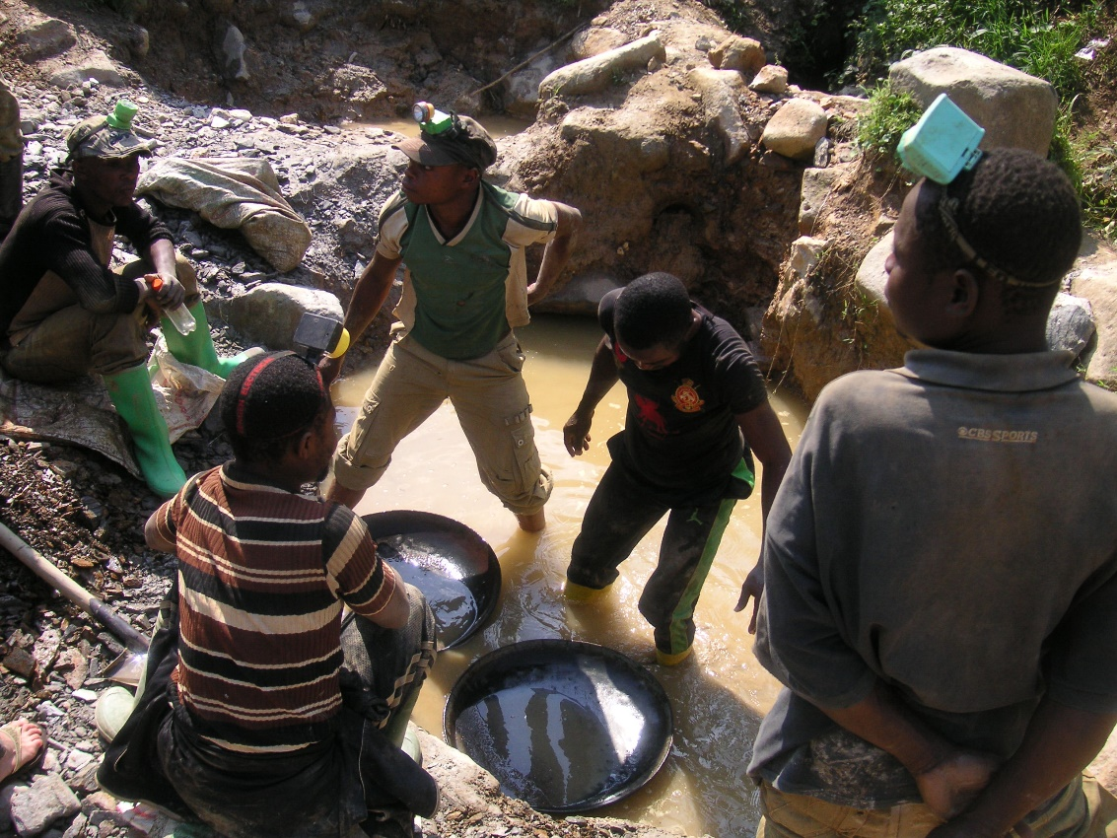
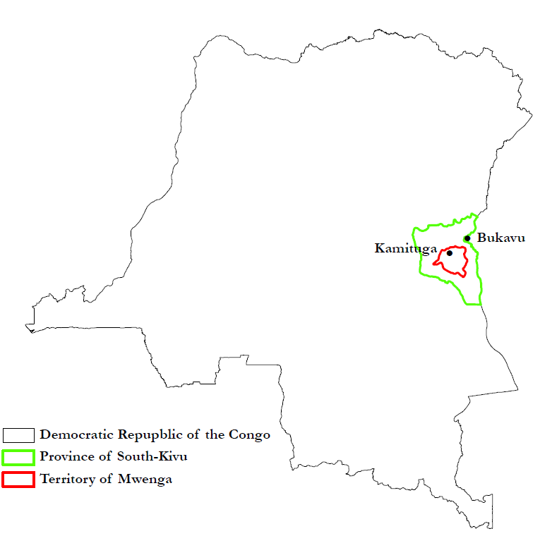
Would you rebel ?
What are the determinants of individual participation in violence ?

Slide 10
“would-be-rebels” are not per se “rebels-to-be”
  Strategic answers (to influence ‘game’ with Banro)
  Social desirability considerations
  Violence is costly and risky: the effect of the actual costs involved may only set in when decision time has come
Notes:
Not perfect, but acceptable given constraints of conflict setting
Don’t let the perfect be the enemy of the good
One possible disadvantage with these data is that the responses may contain a lot of noise and even be untruthful. For example, in formulating their responses, subjects may be influenced by what they believe to be the socially desirable response. Since the first studies in the area, psychologists have found evidence that points to this concern being exaggerated (e.g., Rorer 1965)
It is also possible to show that surveyed preferences for revolt are correlated with observable measures of conflict (show that those who know rebels or who were rebels are also more likely to report becoming a rebel)
Olivier de Sardan, a social anthropologist, (2008: 68) states that a researcher needs “to tinker and to invent appropriate techniques for his own use in accordance with the novelty of his object and approach.”
Check literature on subjective well-being: here also started with wondering what result would be if you just ask person
combination of research methods that best meet the needs of the research question
To capture agents’ motives we must learn about the ideas and thought processes of agents, a task for which qualitative methods are often better suited—although experiments, which tend to produce quantitative data, may also help us get ‘‘inside the heads’’ of agents (e.g., Nisbett & Cohen, 1996).
We evolved to this approach in a trial-and-error fashion. We tried many different things, on paper and in the field… We should sum these up in our methodological section: method is about making choices, mainly pragmatic ones.
Also explain that – because of reality in the field – we needed to restrict sample to Kamituga
But put survey tools available for all those who want to apply it elsewhere
This would have been nice approach: using vignettes, ‘‘short stories about hypothetical characters in specified circumstances, to whose situation the interviewee is invited to respond’’ (Finch, 1987, p. 105).
Quantitative research appears more useful for capturing patterns in the variation of violence and conflict and understanding its distribution and correlates. Qualitative research appears more useful for understanding motivations, experiences of violence and their psychosocial effects, or capturing the processes of violent and conflictual situations.
As noted by Collins (2008) and others, violence is too complex and pressing a social problem to be subjected to methodological puritanism We should take from the range of methodological tools those that may best be applied to our research questions and mix them as seems appropriate. To keep quantitative, qualitative, and formal methods strictly separate is to limit ourselves and to reduce the potential impact of studies on such a critical subject. As Tarrow (1995) admonishes, ‘‘a single-minded adherence to either quantitative or qualitative approaches straightjackets scientific progress’’ (p. 474).

Slide 11
Prominent examples that study the ‘taste to rebel’:
  Muller, Dietz, Finkel, 1991. “Discontent and the Expected Utility of Rebellion: The Case of Peru.” American Political Science Review.
  MacCulloch, 2004. ‘‘The Impact of Income on the Taste for Revolt.’’ American Journal of Political Science.
  Thyne & Schroeder, 2012. “Social Constraints and Civil War: Bridging the Gap with Criminological Theory”. The Journal of Politics.
  → Find that ‘‘taste for revolt’’ is a reasonable proxy for actual violent behavior
Notes:
Don’t let the perfect be the enemy of the good
One possible disadvantage with these data is that the responses may contain a lot of noise and even be untruthful. For example, in formulating their responses, subjects may be influenced by what they believe to be the socially desirable response. Since the first studies in the area, psychologists have found evidence that points to this concern being exaggerated (e.g., Rorer 1965)
It is also possible to show that surveyed preferences for revolt are correlated with observable measures of conflict (show that those who know rebels or who were rebels are also more likely to report becoming a rebel)
Olivier de Sardan, a social anthropologist, (2008: 68) states that a researcher needs “to tinker and to invent appropriate techniques for his own use in accordance with the novelty of his object and approach.”
Check literature on subjective well-being: here also started with wondering what result would be if you just ask person
combination of research methods that best meet the needs of the research question
To capture agents’ motives we must learn about the ideas and thought processes of agents, a task for which qualitative methods are often better suited—although experiments, which tend to produce quantitative data, may also help us get ‘‘inside the heads’’ of agents (e.g., Nisbett & Cohen, 1996).
We evolved to this approach in a trial-and-error fashion. We tried many different things, on paper and in the field… We should sum these up in our methodological section: method is about making choices, mainly pragmatic ones.
Also explain that – because of reality in the field – we needed to restrict sample to Kamituga
But put survey tools available for all those who want to apply it elsewhere
This would have been nice approach: using vignettes, ‘‘short stories about hypothetical characters in specified circumstances, to whose situation the interviewee is invited to respond’’ (Finch, 1987, p. 105).
Quantitative research appears more useful for capturing patterns in the variation of violence and conflict and understanding its distribution and correlates. Qualitative research appears more useful for understanding motivations, experiences of violence and their psychosocial effects, or capturing the processes of violent and conflictual situations.
As noted by Collins (2008) and others, violence is too complex and pressing a social problem to be subjected to methodological puritanism We should take from the range of methodological tools those that may best be applied to our research questions and mix them as seems appropriate. To keep quantitative, qualitative, and formal methods strictly separate is to limit ourselves and to reduce the potential impact of studies on such a critical subject. As Tarrow (1995) admonishes, ‘‘a single-minded adherence to either quantitative or qualitative approaches straightjackets scientific progress’’ (p. 474).

Slide 12
A handful of studies have looked at “have-been-rebels”
  Verwimp 2005 “An Economic Profile of Peasant Perpetrators of Genocide: Micro-level Evidence from Rwanda.” Journal of Development Economics
  Humphreys and Weinstein 2008. “Who Fights? The Determinants of Participation in Civil War.” American Journal of Political Science
These studies have their own caveats
  the non-randomness of the sample of ex-combatants
  recall bias of the pre-conflict characteristics of the respondents
→ material incentives perform far better at predicting individual behavior than proxies for political grievances, but absence of evidence is not evidence of absence.

Slide 13
Majority of studies on individual participation is ethnographic
  Scott 1976. Moral Economy of the Peasant: Rebellion and Subsistence in Southeast Asia. New Haven and London: Yale University Press.
  Wood 2003. “Insurgent Collective Action and Civil War in El Salvador”. Cambridge and New York: Cambridge University Press.
  Kalyvas and Kocher 2007. “How ‘Free’ Is Free Riding in Civil Wars? Violence, Insurgency and the Collective Action Problem.” World Politics
→ Challenge rational actor theory
Notes:
grievances may be difficult to measure and their role may depend on context.
Economists and political scientists have begun to conduct surveys of excombatants in Burundi, Colombia, Liberia,
Sierra Leone, and Uganda (Jeannie Annan et al. 2008; Ana M. Arjona and Kalyvas 2008; Humphreys and Weinstein 2004; Eric
Mvukiyehe, Cyrus Samii, and Gwendolyn Taylor 2008; James Pugel 2007), some still works in progress. These surveys explore who
the combatants were, where they came from, and their prewar experiences. Comparisons across armed groups, or to civilians, suggest
motivations for joining an armed group or committing particular acts of war.
As McGovern (2011, p. 350) points out, micro-level studies suggest that ‘‘participants in violent politics [operate] according to rational and irrational choice models at once’’ (see also, Wood, 2003)

Slide 14
Studies on individual participation in DRC are all ethnographic
  Van Acker & Vlassenroot 2001. War as exit from exclusion: the formation of Mayi-Mayi militias in Eastern Congo. Afrika Focus.
  Jourdan 2011. Mayi-Mayi: young rebels in Kivu, DRC. Africa Development.
  Laudati 2013. Beyond minerals: broadening ‘economies of violence’ in eastern Democratic Republic of Congo. Review of African Political Economy.
  Richards 2014. Forced, coerced and voluntary recruitment into rebel and militia groups in the Democratic Republic of Congo. The Journal of Modern African Studies.
→ indications of many mechanisms: Greed; Low opportunity costs; Grievance; Community cohesion & Patriotism and related non-material incentives; Protection from harm and insecurity; Forced recruitment
Notes:
No insight into the relative importance of the different mechanisms, in part because no “test” of competing hypotheses, and in part because they only consider ex-combatants

Slide 15
Literature on “artisanal miners” in DRC and their confrontation with mining companies:
  van Puijenbroek & Schouten (2013) “Le 6ième Chantier ? L’économie politique de l’exploitation aurifière artisanale et le sous-développement en Ituri. » L’AFRIQUE DES GRANDS LACS. ANNUAIRE 2012-2013
    on tensions in Ituri: « la plupart des miliciens se sont convertis en creuseurs » (p. 227) « Ici c’est la guerre. Quand la société minière vienne ici nous déplacer, nous serons prêtes ; même les mamans sont en colère et ont leurs arcs et flèches prêtes » (p. 29)
  Geenen and Claessens (2013) “Disputed access to the gold sites in Luhwindja, eastern DRC.” J. Mod. Afr. Stud.
    on tensions in South-Kivu: “‘They are fooling us. They say they will give you work and the next day they chase you off. …So the only choice we had was to reoccupy this concession. They threatened us with policemen and dogs. We told them to do what they want, but we will not die because of hunger! [. . .] We would rather die by a bullet than die of hunger’. (Miners focus group 2011 int.)” (p.26)
Notes:
« On pourrait en fin de compte considérer l’orpaillage comme méthode de DDR très efficace. On estime que les jeunes qui ont fait partie des groupes armés s’adaptent facilement à l’orpaillage comme mode de vie –……la plupart des miliciens se sont convertis en creuseurs » (p. 227)
« tous sont inquiets des visites inopinées des ingénieurs d’AGK ; des rumeurs parmi la population donnent lieu a des tensions et même, dans certains endroits, à une atmosphère de guerre. Comme une « Maman Restaurant » commentait : « Ici c’est la guerre. Quand la société minière vienne ici nous déplacer, nous serons prêtes ; même les mamans sont en colère et ont leurs arcs et flèches prêtes. Nous avons besoin de ça [l’orpaillage] et restons ! » (p. 229)

Slide 16
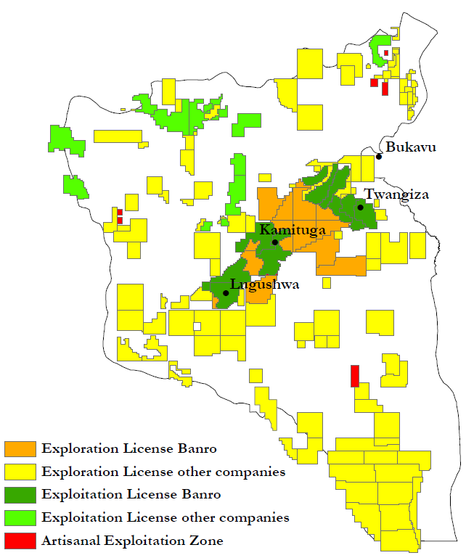
Kamituga (city of 190,000)
2011: Exploration
Already some restrictions:
  No new pits; Research areas off limits
  No Dynamite, Crushing mills, Electricity
Production phase will have huge implications for 13,000 - 15,000 artisanal miners
Notes:
2002 Mining Code favors large-scale mining
dependent on ASM: up to 10 million people
16% of DRC’s population
Kamituga: Tension ASM - LSM
September 2013: Mining Police & FARDC remove crushing mills
April 2015: 10 "new" mining pits closed by Mining Police
May 2015: 3 mining pits closed by Mining Police due to destruction Banro tent
May 2015: Banro cut electricity access to 5 mining sites
October 2014 - April 2015: increased intrusion of artisanal miners in Banro "research zones«
In practice there is a duality and tension bet
Banro, a Canadian mining company, was the first large-scale mining company to start exploration activities again in South-Kivu
They obtained three large exploration permits in South-Kivu (which you can see on the map here): Twangiza, Kamituga and Lugushwa
A fourth one, Namoya, is located in Maniema province, close to the border with South-Kivu
Banro first focussed its attention on the Twangiza mining site, where it started exploration activities in 2005 and actual production in 2011
Geenen, and Geenen & Claessens have studied the relationship between artisanal and industrial mining at the Twangiza gold mining concession
They describe how the development of the Twangiza mine has led to the dispossession and displacement of local communities
After facing significant resistance from the local population, Banro did set up a community forum to discuss issues of resettlement and compensation,
and they organized training and employment programs. Geenen and Geenen & Claessens argue however that these measures have only benefitted a small part of the affected population and are unlikely to bring relief in the long run.
This is illustrated by the fact that after these programs ended, mid 2011, 500-900 artisanal miners - lacking alternative livelihood options - reoccupied artisanal mining sites which were previously closed down by Banro
They still remain there and a sustainable solution is yet to be found.
However, the ASM livelihood has been under pressure in the past decade, as the Government has been actively trying to attract foreign direct investments in the mining sector.
The main legal documents that govern DRC’s mining sector today are the Mining Code and Mining Regulations which were introduced in 2002 and 2003 respectively.
They were established under the guidance of the World Bank and the IMF and were aimed at stimulating private investments in Large Scale Mining
The documents explicitely recognize artisanal mining, but state that it may only take place in AEZ
The government created very few of them
They are often located in remote areas which are hard to reach
And no geological studies have been conducted to determine the mineral reserves
Moreover the AEZ cover only very small areas, especially relative to the size of the concessions granted to LSM
This is a map of South-Kivu, drawn with data from the Cadastre Minier
The green, yellow and orange rectangles represent exploration and exploitation permits granted to LSM.
The AEZ are depicted in red. Currently, there are only 7 of them.
In practice, ASM takes place everywhere, including in the mining concessions granted to industrial companies, which creates a duality and tension between ASM and LSM in several concessions.
« De Jure » artisanal miners are thus invaders engaged in illegal activities – and LSM has the upper hand
… The mining regulations further specify that artisanal miners need to obtain a yearly permit, the « carte d’exploitant artisanal »
and need to comply to a nr. of regulations on safety, the use of water and environmental standars
Our research is focussed on the Mining site of Kamituga (show location on map)
Banro entered the exploration phase in 2011,
When they do move to the production phase, however, the impact will arguably be even larger than it has been in Twangiza
After Bukavu and Uvira, Kamituga is one of the most populous cities of South-Kivu, with an estimated population of 187,000 inhabitants
The number of artisanal miners is estimated between 13,000 and 15,000 (13,000 on a COKA list – 2,250 on a CRC list --- other estimates say 13,600 mines in 2013).
Using the World Bank’s methodology of 5 dependents per miner, this means that up to 70,000 people or 37% of Kamituga’s population is directly dependent on ASM
Many more are indirectly dependent on ASM as gold from artisanal mining fuels the local economy and it’s activities
As Banro is still in the exploration phase, they tolerate ASM to a certain extent
In several sites, artisanal miners are not allowed to open new pits and some sites are off limits for
Furthermore, semi-industrial modes of production are prohibited: miners are not allowed to use dynamite or crushing mills or electricity
Violations of these prohibitions have already led to several incidents between the miners and Banro, who have used the Mining Police and FARDC to restore order

Slide 17
CONTRIBUTION: study the “taste to rebel” among high-risk men…
… in a post-conflict environment
Test for influence of (past) conflict exposure/participation
…that face perceived injustice and threat of unemployment
A strong test for both the deprived and rational actor theory
  … part of a large-N survey, N=469
  → First of its kind in DRC
Notes:
Looting opportunities (minerals, other natural resources, roadblocks)
setting with severe objective deprivation and a history of rebellious conflict

Slide 18
Method

Slide 19
Would you rebel ?
What are the determinants of the individual intention to participate in violence ?

Slide 20
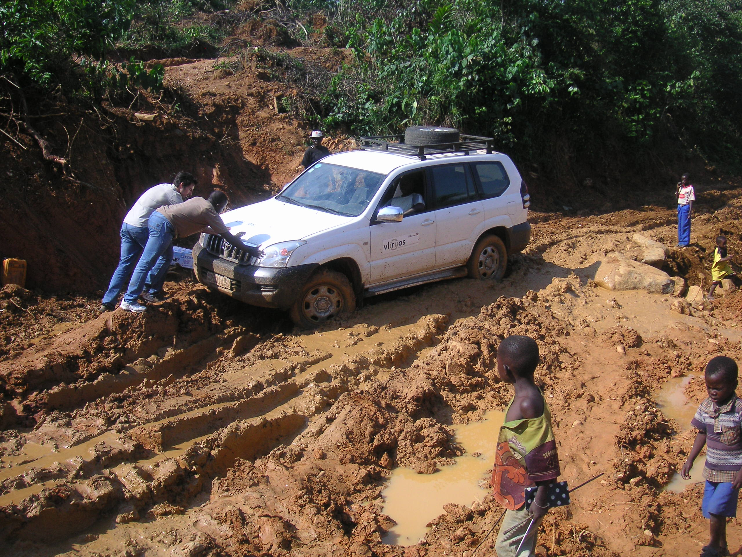

Slide 21
Census and Sampling

Slide 22
After our census and sampling, we conducted two pilots in June 2014 and December 2014.
The final research design, implemented in May 2015, was shaped by the usual financial constraints, but also by several practical and security challenges
  The climate in Twangiza was too tense → it was impossible to draw a random sample and conduct independent research → limit research to Kamituga
  No bank in Kamituga, and not safe to carry too much cash around → limit “games”
  Miners suffered from “gold fever” and became agitated if they had to leave their shaft for more than one hour → limit interview time
  On the other hand, many questions we thought would be sensitive were not → list experiment not needed

Slide 23
Representative sample of 469 miners in Kamituga, stratified across several mining areas (after “census” of miners)
Script that established our objectivity and respondents' anonymity
Structured survey (with a few open questions)

Slide 24
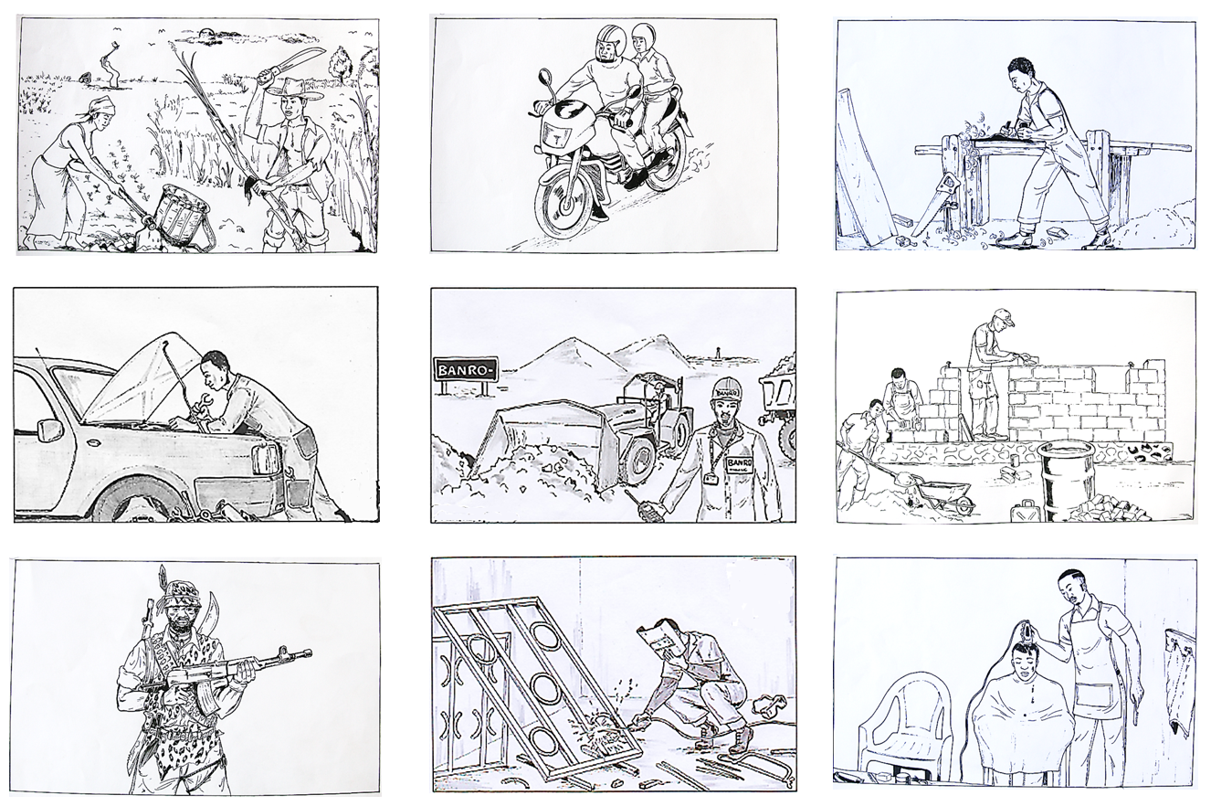
Q.REBEL 1: « Should artisanal mining no longer be possible in Kamituga, to what extent would you be interested in conducting these alternative activities ? »
Very interested – somewhat interested – rather indifferent – not interested
Notes:
Social desirability bias may kick in
Focusing on two distinct forms of ‘rebelling’
joining armed group
Can be greed or grievance, but we framed it as “greed”, i.e. one among many alternative income sources to mining

Slide 25
Q.REBEL 2: « Imagine a situation where Banro moves to the production phase in Kamituga.
Imagine that they organize professional training programs and authorize some artisanal miners to continue operating in selected mining sites at Kamituga.
However, their budget is not sufficiently large to accommodate all miners in the training programs, and the selected mining sites are not sufficiently large to accommodate all artisanal miners.
In such a situation, would you join or revitalize an armed group (like Mai Mai Shikito or a Local Defense Force) »
Certainly not – Probably not – Maybe – Probably - Certainly
Notes:
Socialization, community fibre may kick in
(2) rioting/revolting against Banro
Can be greed or grievance, but we framed it as “grievance”, i.e. actions should Banro move to production phase and not be able to accommodate all miners

Slide 26
Taste to rebel 1, 2 = f(…)
Material selective incentives
Non-Material selective incentives
wealth, income, outside options, schooling
victimization, grievances, family responsibilities, rebel network, community ties
Perform t-tests and spearman rank correlation for each of these variables, by(intention to rebel)
Estimate multivariate probit model, including variables of each category
Notes:
social control theory

Slide 27
Data
Notes:
This paper asks a simple question “Would they Rebel ?”. We ask this question to artisanal miners in South-Kivu, DRC.

Slide 28
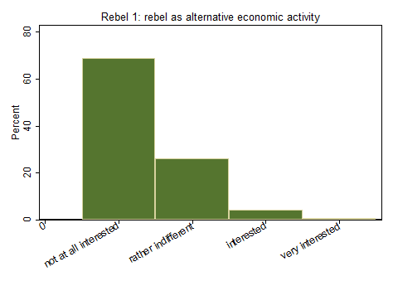
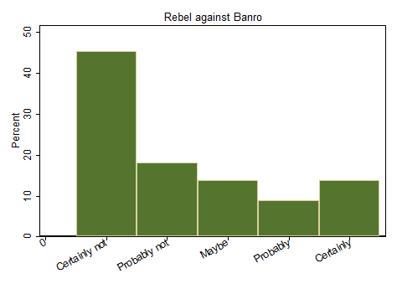
Would you rebel?
REBEL 1 REBEL 2
36.6%
31.4%
22.8%
5.4%
Correlation: 0.09 & 0.28
Notes:
larger proportion says they will joing some armed group; it is framed in grievance context
Note: correlation between these two is VERY low

Slide 29
Taste to rebel 1, 2 = f(…)
Material selective incentives
wealth, income, outside options, schooling
Asset index, Mud floor, Weekly income, Reservation wage, ‘Ladder of life’, Number of activities in the household, Agriculture, Expected opportunities at Banro, Educational attainment

Slide 30
Assets, e.g. housing

Slide 31
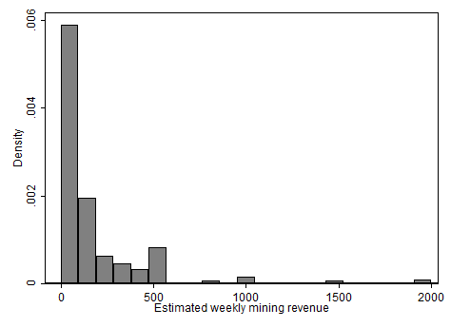
Income

Slide 32
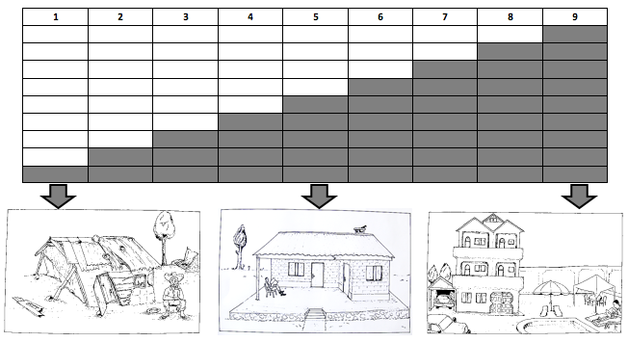
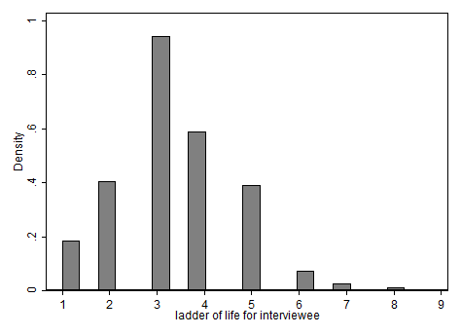
Ladder of life

Slide 33
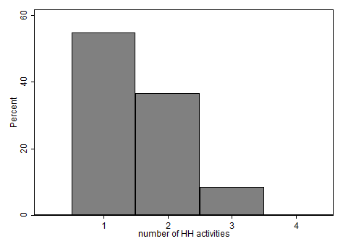
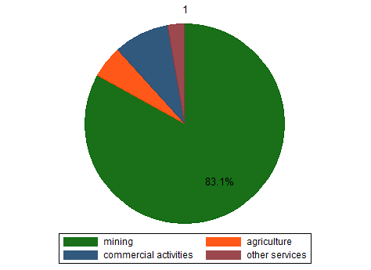
Income diversification

Slide 34
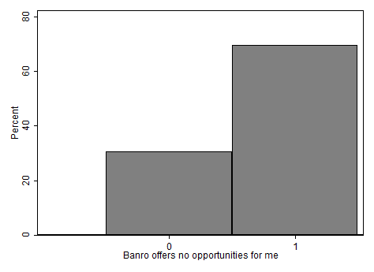
Banro offers no opportunities

Slide 35
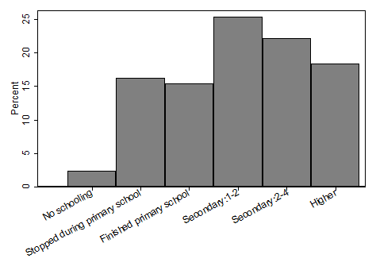
Schooling

Slide 36
Taste to rebel 1, 2 = f(…)
Non-Material selective incentives
victimization, rebel network, grievances, family responsibilities, community ties
Exposure to armed conflict, Has been a rebel, Has good friend who was rebel, Reckons many among artisanal miners were rebels, Works in pit that includes self-reported rebel, Satisfaction with services of several state and non-state actors, Marital Status, Nr. Children, Ethnicity, Place of birth

Slide 37
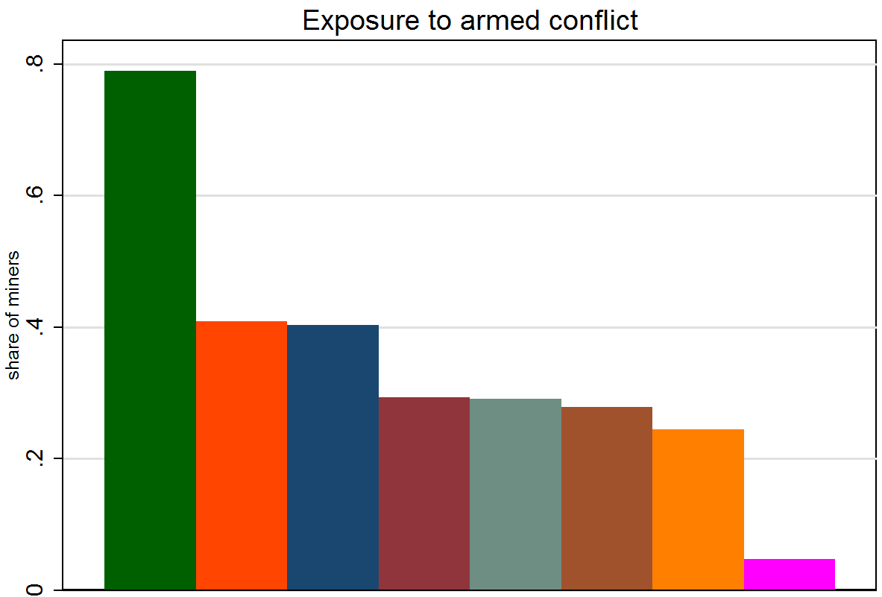
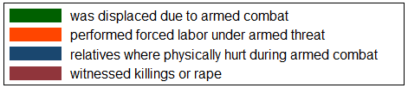
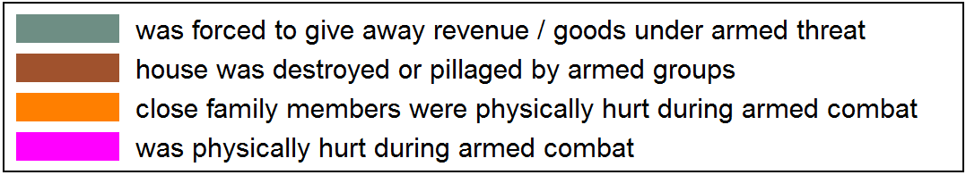
No exposure: 7%
Notes:
Displaced due to armed combat very high

Slide 38
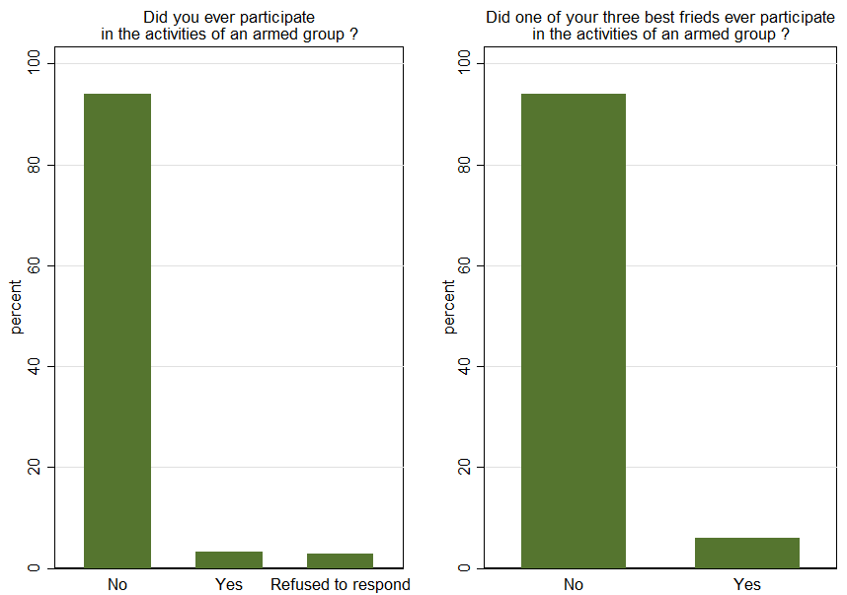
Rebel network
0.06 * 14,000 = 840
6 %
6 %
3 %
3 %
Notes:
If 6% has participated in activities of rebel group before, and if sample is representative ➔ 14,000 *0.06 = 840 ex-rebels
almost certainly an underestimage ➔ nr. of miners is larger & people are probably likely to underreport their own or their friend’s participation in armed groups.
We have anecdotal evidence that about 800 ex-rebels were reintegrated in the territory of Mwenga within the DDR program
About 600 of them supposedly ended up in Kamituga and are currently engaged in artisanal mining
➔ local NGO PIAP worked with 600 ex-combattants in Kamituga – were in charge of giving them a monthly wage
➔ CONADER (Commission Nationale de Demobilisation et de Reinsertion des Ex-Combattants)
➔ Demobilisation disarmement reintegration

Slide 39
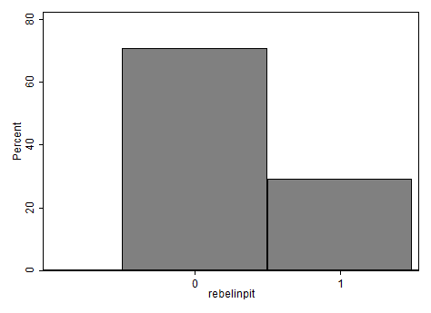
Rebel in the miner’s shaft
23%

Slide 40

‘Grievances’
Inquire about impact of several actors on well-being: Banro, Chef de Poste, Mwami, COKA, CRC, SAESSCAM, Division des mines, FARDC, Police des Mines and maimai Shikito.
Respondents were shown a set of five smileys,
which were explained to represent the following answers categories:
- very negative effect
- rather negative effect
- no effect
- rather positive effect
- very positive effect

Slide 41
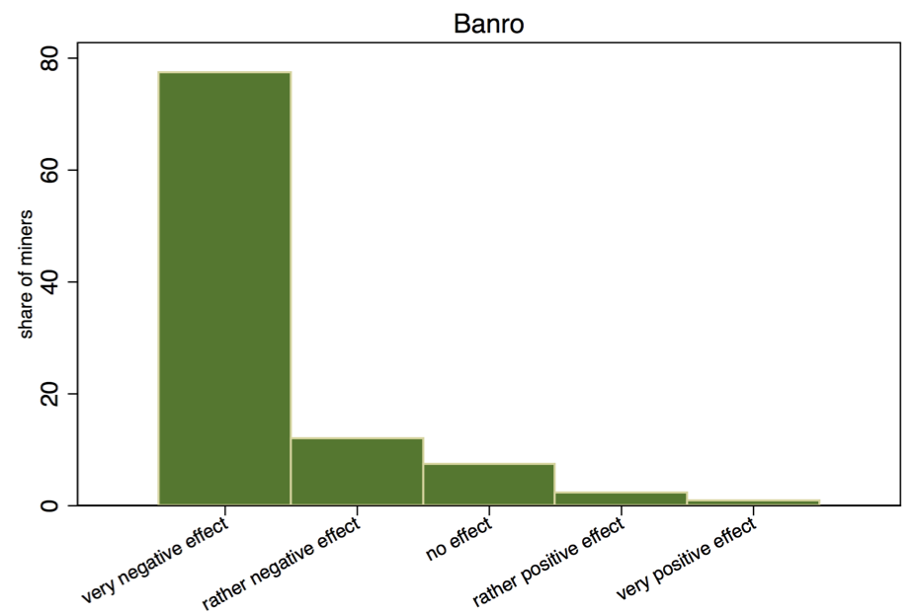

Slide 42
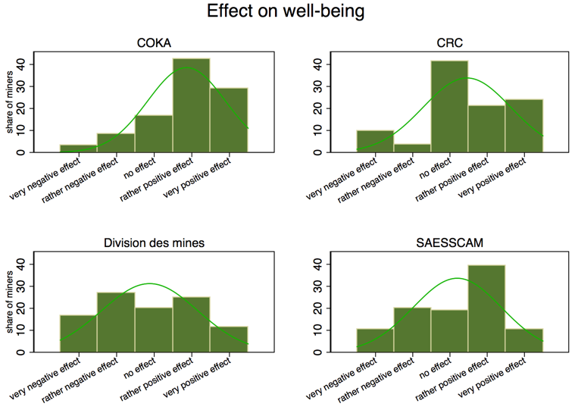

Slide 43
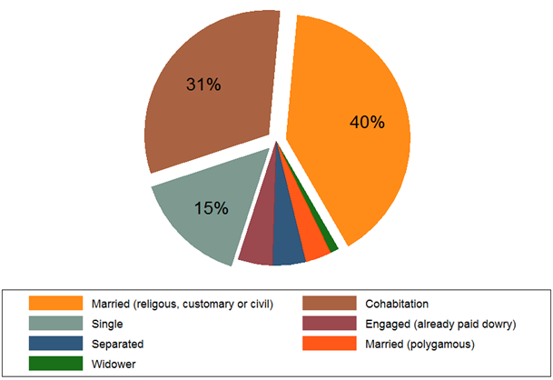
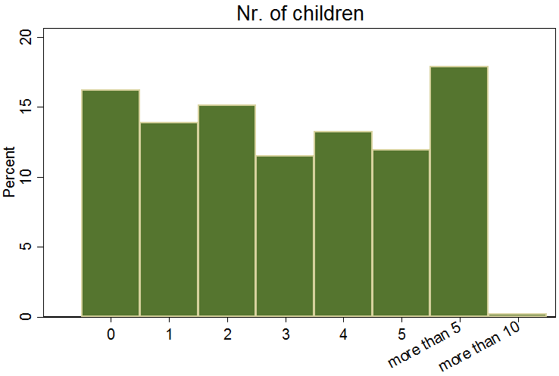
Family ties

Slide 44
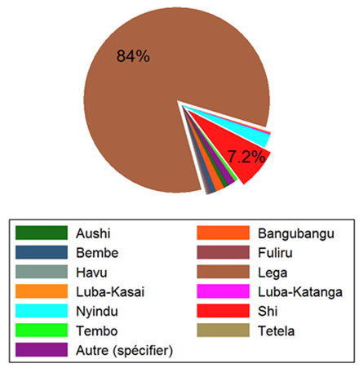
Community ties
Location of birth
 | Miners | Parents
South-Kivu (province) | 97% | 96%
Mwenga (territoire) | 84% | 82%
Mwamuzimu (chefferie) | 68% | 45%
Kamituga | 52% | 20%

Slide 45
Results

Slide 46
Remember this:
REBEL 1 REBEL 2
36.6%
31.4%
22.8%
5.4%
Correlation: 0.09 & 0.28
Notes:
larger proportion says they will joing some armed group; it is framed in grievance context
Note: correlation between these two is VERY low

Slide 49
sum
sum
sum

Slide 50
Important multi-collinearity

Slide 51
Multivariate probit

Slide 52
OLS

Slide 53
Conclusion
Strongest predictors: outside options, victimization, and rebel network
Relatively strong predictors: income and asset wealth (because can operate in both directions: not much to loose & lots at stake)
Relatively weak predictors: grievances
Weakest predictors: family and community ties
→ NOTE: in contrast to self-reported reasons

Slide 54
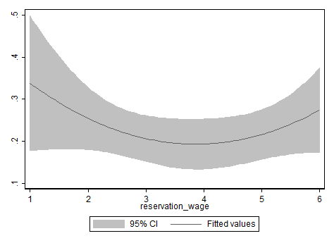
Quadratic fit

Slide 55
Indicate the importance of the following potential motivations to join an armed group :

Slide 56
Conclusion
Strongest predictors: outside options, victimization, and rebel network
Relatively strong predictors: income and asset wealth (because can operate in both directions: not much to lose & lots at stake)
Relatively weak predictors: grievances
Weakest predictors: family and community ties
→ NOTE: in contrast to self-reported reasons
→ POLICY : DDR + transitional justice

Slide 57
Self-reported reasons to rebel

Slide 58
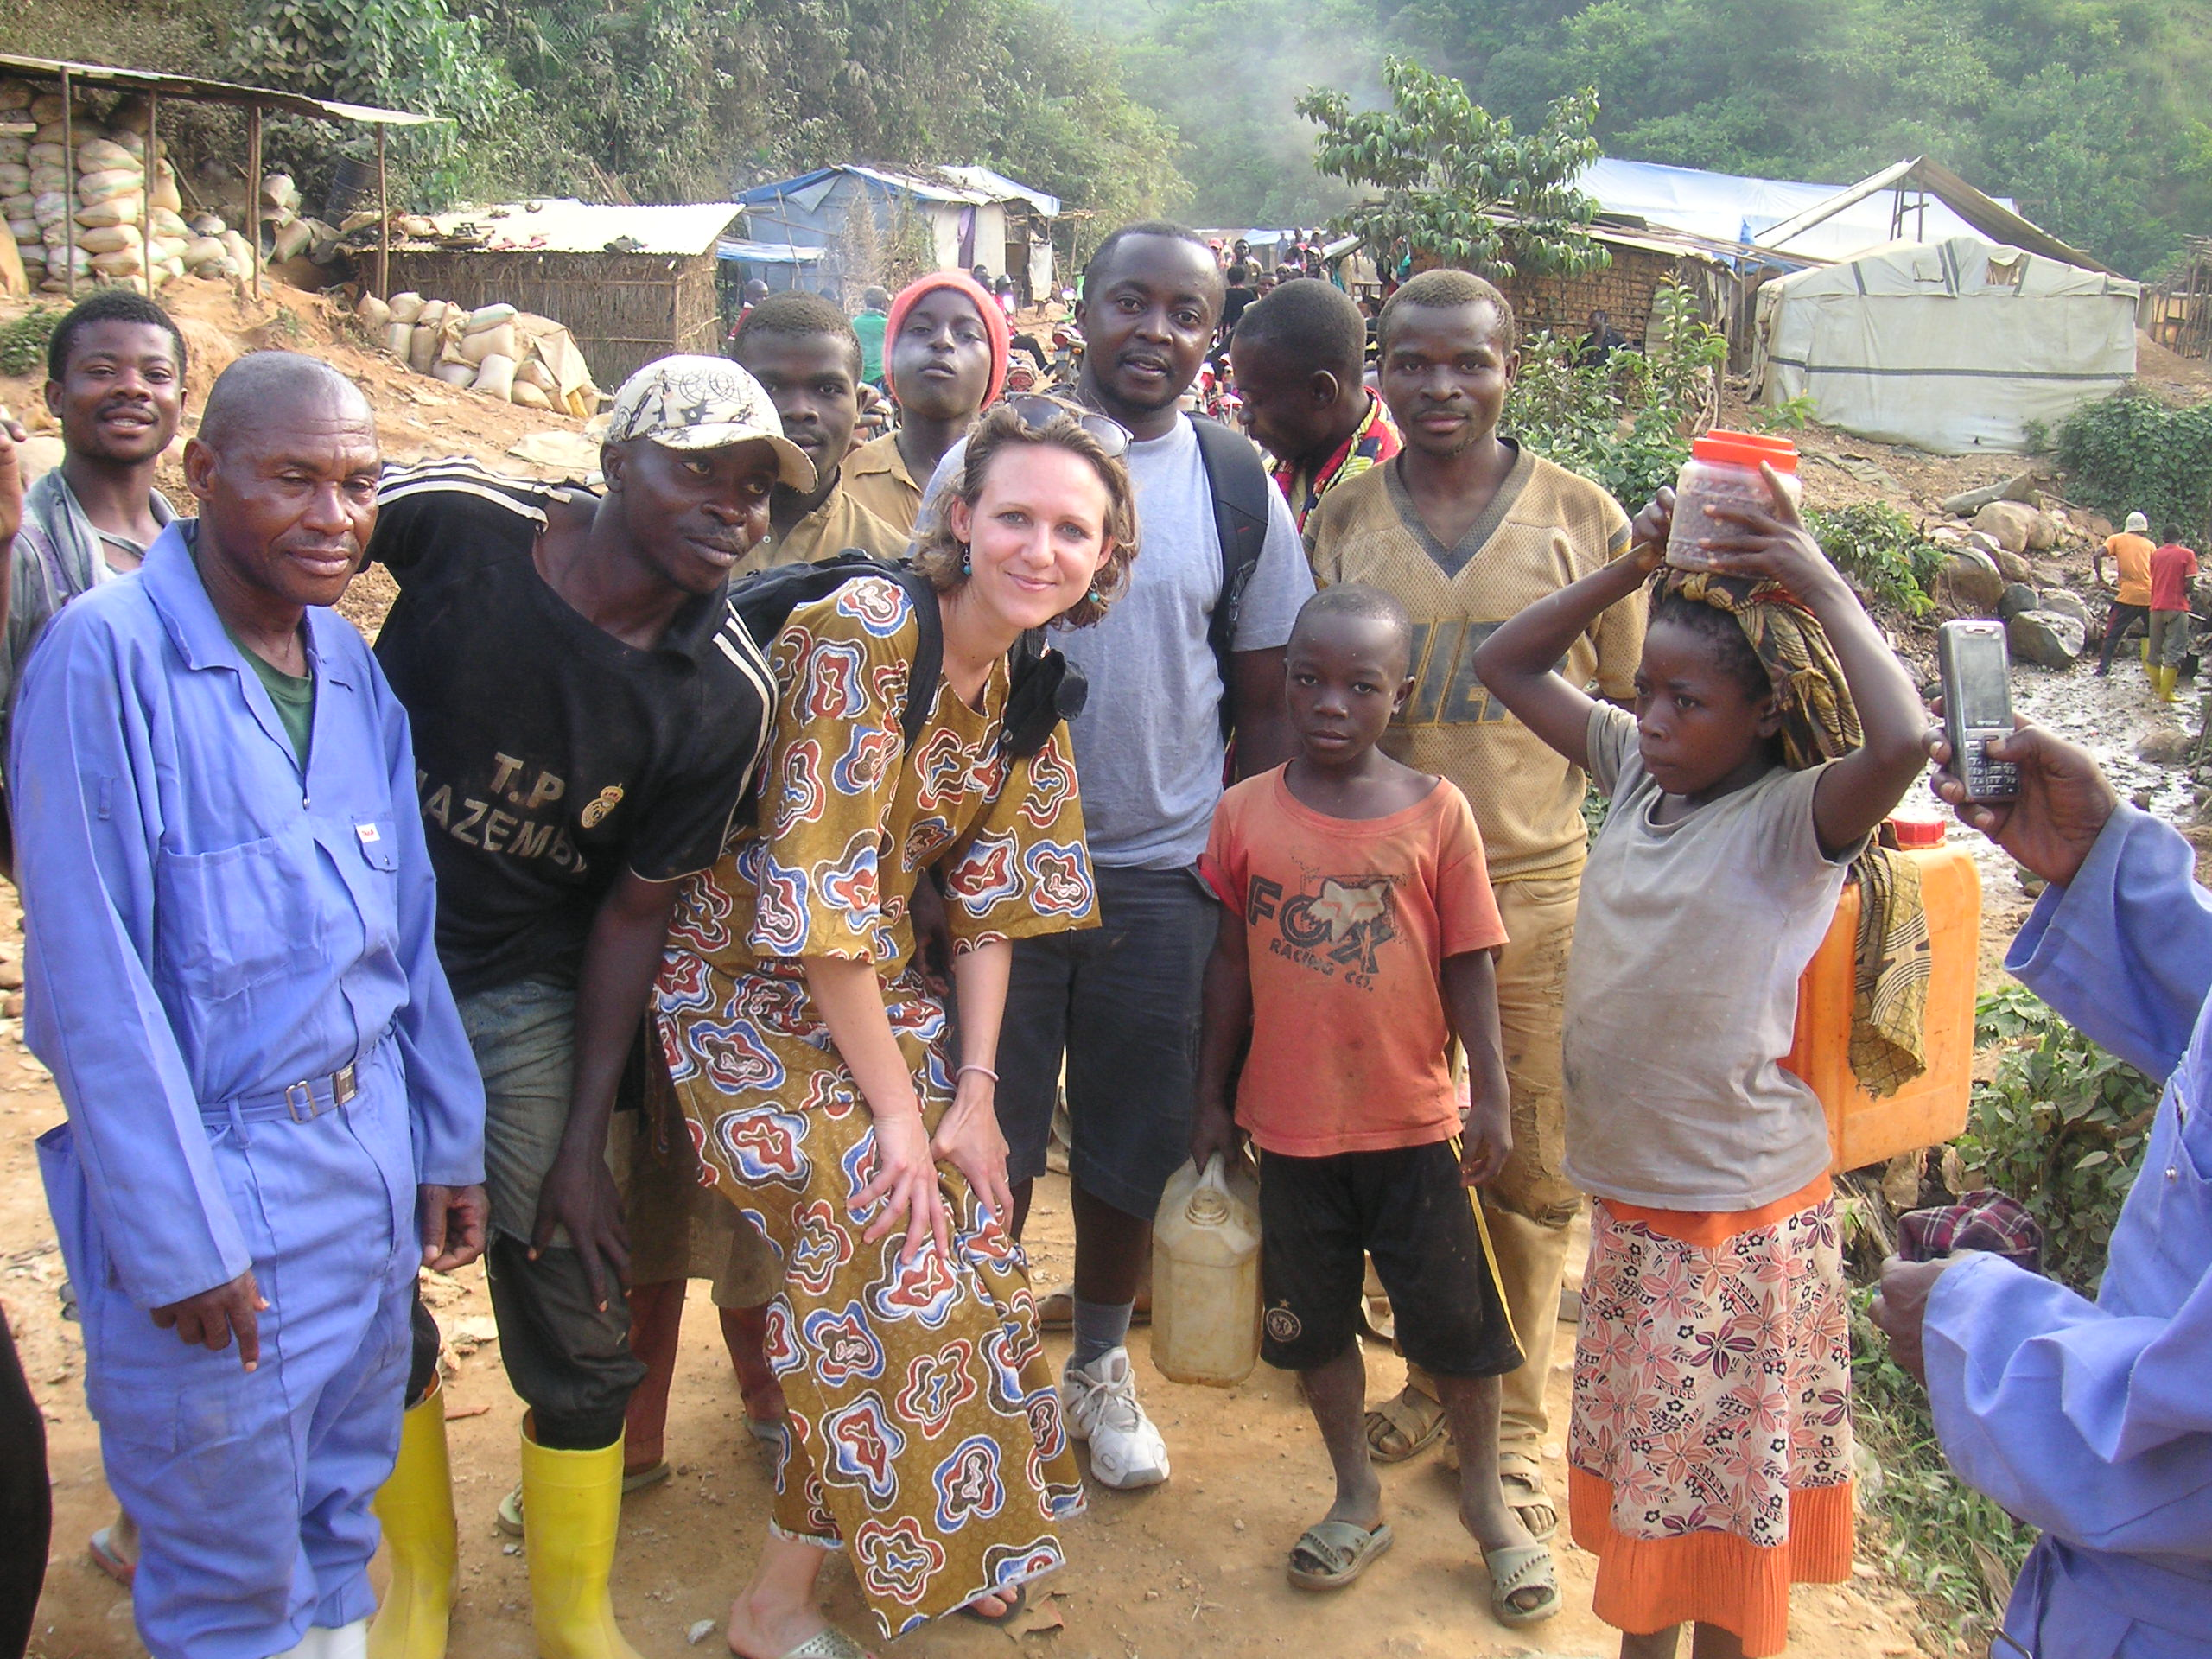
The End

Slide 59
Appendices
Notes:
This paper asks a simple question “Would they Rebel ?”. We ask this question to artisanal miners in South-Kivu, DRC.

Slide 60
Interaction effects

Slide 61
…in order to inform policy objectives and design
  US general Iraq: finding jobs for ‘‘angry young men’’ was ‘‘absolutely critical to lowering the level of violence’’ (Dept. of Defense 2006).
  Tanzanian President Kikwete’s : ‘‘We have seen how some youths with no job prospects and little hope of getting any have become the petrol to raging tires in conflict . . . they easily fall prey to war lords, criminal gangs and political manipulators to the detriment of peace and stability in their countries’’ (UN News Service 2009).
Notes:
Department of Defense, Press Briefing with Lt. Gen. Peter Chiarelli, U.S. Army Commander, Multinational Corps Iraq, 8 Dec. 2006. Available at http://www.globalsecurity.org/military/ library/news/2006/12/mil-061208-dod01.htm.
United Nations (UN) News Service. 2009. ‘‘Global Help Needed to Curb Youth Unemployment in Africa, Tanzania Says at
UN.’’ 25 Sept. 2009. Available at http://allafrica.com/stories/ 200909250137.html.

Slide 62
From wikipedia
The First Congo War (1996–1997) was a foreign invasion of Zaire led by Rwanda that replaced dictator Mobutu Sésé Seko with the rebel leader Laurent-Désiré Kabila. Destabilization in eastern Zaire resulting from the Rwandan Genocide was the final factor that caused numerous internal and external factors to align against the corrupt and inept government in the capital, Kinshasa.
The new government renamed the country to the Democratic Republic of the Congo, but it brought little true change. Kabila alienated his Rwandan and Ugandan allies. To avert a coup, Kabila expelled all Rwandan and Ugandan forces from the Congo. This event was a major cause of the Second Congo War the following year. Some experts prefer to view the two conflicts as one war

Slide 63
From wikipedia
The Second Congo War (also known as the Great War of Africa or the Great African War) began in August 1998. The war officially ended in July 2003, when the Transitional Government of the Democratic Republic of the Congo took power. Although a peace agreement was signed in 2002, violence continued in many regions of the country, especially in the eastern region. Hostilities have continued since in the ongoing Lord's Resistance Army insurgency, and the Kivu and Ituri conflicts.
Named the deadliest war in modern African history, the Second Congo War has directly involved nine African countries, as well as approximately 20 separate armed groups. By 2008, the war and its aftermath had caused 5.4 million deaths, principally through disease and starvation, making the Second Congo War the deadliest conflict worldwide since World War II. Another 2 million are displaced from their homes or sought asylum in neighbouring countries.
Despite a formal end to the war in July 2003 and an agreement by the former belligerents to create a government of national unity, 1,000 people died daily in 2004 from easily preventable cases of malnutrition and disease.

Slide 64
From wikipedia
Under the leadership of South Africa, peace talks held between April and December 2002 led to the signing of a "comprehensive peace agreement." The Sun City Agreement was formalised on 19 April 2002. It was a framework for providing the Congo with a unified, multipartite government and democratic elections. However, critics noted that there were no stipulations regarding the unification of the army, which weakened the effectiveness of the agreement. There were several reported breaches of the Sun City agreement, but it has seen a reduction in the fighting.
On 30 July 2002, Rwanda and the Democratic Republic of Congo signed a peace deal known as the Pretoria Accord after five days of talks in Pretoria, South Africa. The talks centered on two issues. One was the withdrawal of the estimated 20,000 Rwandan soldiers in the Congo. The other was the rounding up of the ex-Rwandan soldiers and the dismantling of the Hutu militia known as Interahamwe.
Signed on 6 September, the Luanda Agreement formalised peace between Congo and Uganda. The treaty aimed to get Uganda to withdraw their troops from Bunia and to improve the relationship between the two countries, but implementation proved troublesome.
On 21 October, the UN published its Expert Panel's Report of the pillage of natural resources by armed groups. Both Rwanda and Uganda rejected accusations that senior political and military figures were involved in illicit trafficking of plundered resources.
On 17 December 2002, the Congolese parties of the Inter Congolese Dialogue (the national government, the MLC, the RCD, the RCD-ML, the RCD-N, the domestic political opposition, representatives of civil society and the Mai Mai) signed the Global and All-Inclusive Agreement. The Agreement described a plan for transitional governance that would have result in legislative and presidential election within two years of its signing and marked the formal end of the Second Congo War.
On 18 July 2003, the Transitional Government came into being as specified in the Global and All-Inclusive Agreement out of the warring parties. The Agreement obliges the parties to carry out a plan to reunify the country, disarm and integrate the warring parties and hold elections. There were numerous problems, resulting in continued instability in much of the country and a delay in the scheduled national elections from June 2005 to July 2006.

Slide 65
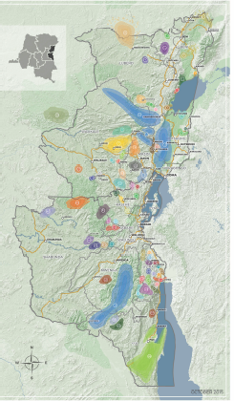
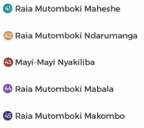
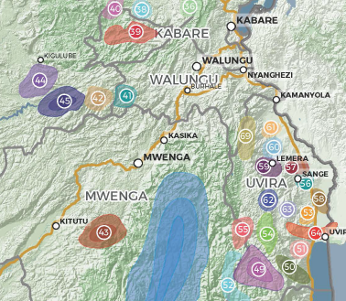
“the government and its foreign partners have been unable to create a virtuous cycle of economic
development in the rural Kivus that could entice local leaders to invest in stability rather than conflict”
Kamituga
Notes:
While it is encouraging to see an end to Kinshasa’s incessant negotiations8 with armed groups, the result has been a singlemindedly
military approach to the conflict, both by the Congolese government and the UN peacekeeping mission. Despite two
rounds of a stabilization program, the government and its foreign partners have been unable to create a virtuous cycle of economic
development in the rural Kivus that could entice local leaders to invest in stability rather than conflict

Slide 66
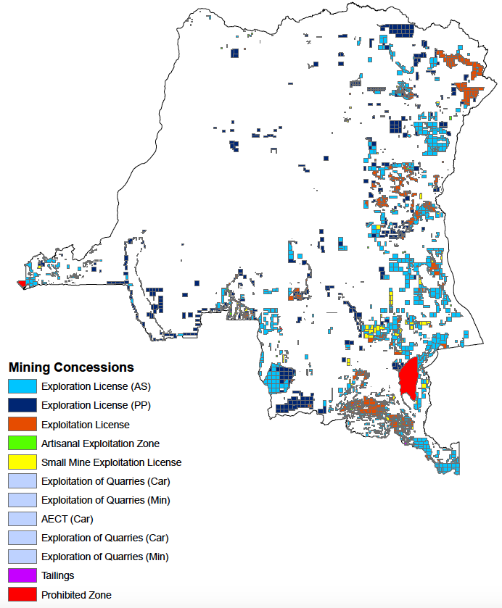
Compiled by Nik, based on the 2015 CAMI database

Slide 67
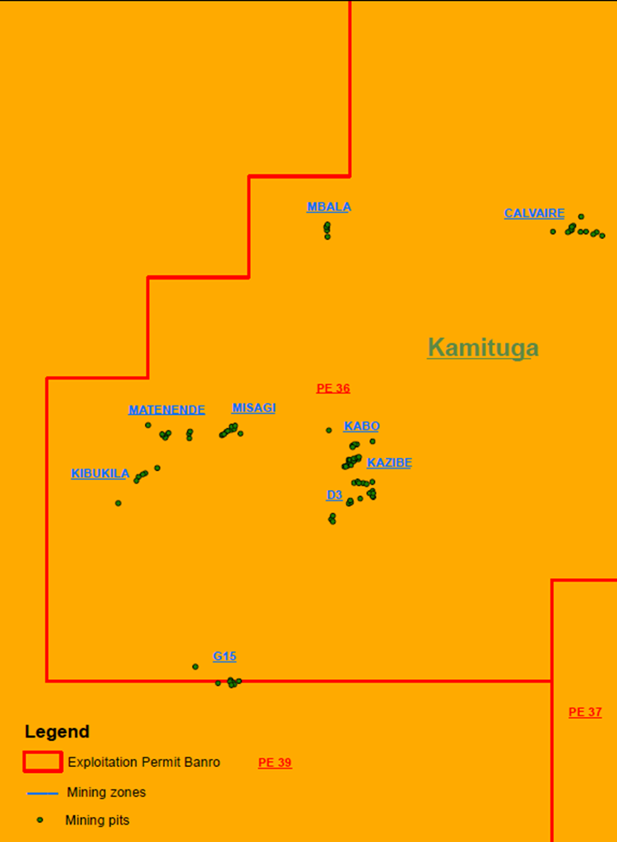
Research set-up
Fieldwork
June & December 2014:
focus groups, interviews, pilot survey, trying out games, visting Twangiza
April-May 2015:
structured survey in Kamituga
Sampling
List of mining sites ➔ 9 / 40
List of all actors in each selected site
  Chef de colline
  list of pit managers (PDG) ➔ 72
  list of artisanal miners ➔ 1,254
Random selection
  ≈ 50% pits, PDG + 10 miners
  39 pits
  469 obs. (430 miners, 39 PDG)
Notes:
In terms of research set-up, we started with two exploratory rounds of fieldwork – organized in June and December 2014
During these trips we visited Kamituga and Twangiza, we held focus group interviews with artisanal miners and interviewed different stakeholders (mining committees, Banro people, SAESSCAM, chef de poste, …)
We also implemented the pilot of a structured survey, both in Kamituga and Twangiza. Miners in Twangiza were however much more reluctant to speak with us, believing that we were somehow related either to Banro or to Government services. It took a while before we were allowed to interview some miners individually, without the committee representatives being present.
Due to this situation, we felt that it would be difficult to have the freedom to conduct individual interviews with individuals of our choice.
We therefore first focused our attention on Kamituga where we implemented the structured survey in the period April – May 2015
We tried to get as close to a representative sample as possible – which was challenging since, as you can imagine, there are no reliable up to date lists of artisanal miners
We worked together with the representatives of two committees of artisanal miners (COKA – Comité des Orpailleurs de Kamituga & CRC – Comité de Renaissance de Calvaire) to draw up a list of active mining sites
From the list of 40 active sites, we selected 9 in order to get sufficient variation in terms of geographical location, distance from the center of Kamituga, the approximate number of artisanal miners and the presence of Banro
Our 12 enumerators then worked together with agents of the mining committees to constitute a list of all actors in each selected site
First the « chef de colline » or the manager of the site was contacted in order to provide us with a full list of Pit Managers – 72 in total
From each PDG we then obtained a list of artisanal miners working with him, in total 1,254
We then used these lists to randomly select our sample
In each mining site we randomly selected half of the pits
From each pit we randomly selected 10 miners to be interviewed, the PDG of each pit was interviewed as well
Average pitsize: 17
When pits were smaller than 10 miners we selected an additional pit in the mining site
When pits were larger than 30 miners, we selected 15 miners in that pit
In total we have 469 observations ➔ 430 miners & 39 PDG
Alternatives we considered
List experiment, Lab-in-the-field experiments,….
Ex-post confrontation survey in Twangiza
But in pilot: cost > benefits
“Pragmatic” approach

Slide 68
(1) Je m’appelle .... Je suis venu dans le cadre d’une étude qui est menée en collaboration avec l’université Catholique de Bukavu et deux universités Belges: l’université d’Anvers et l’université de Louvain. (2) Depuis quelques années nous faisons la recherche sur le secteur minier au Sud-Kivu. Nous parlons aux creuseurs afin de mieux comprendre leur situation et leur perspective du futur. Aujourd’hui cette recherche nous a amené auprès de vous. (3) Il faut dire que cette recherche n’a aucun bénéfice direct pour vous. Si vous décidez de participer et de répondre avec franchise vous nous aiderez simplement à mieux comprendre la situation des creuseurs à Kamituga. (4) Cette recherche aidera alors à mieux informer les différentes acteurs impliqués dans le secteur minière au Sud-Kivu pour que ces acteurs puissent mieux développer leurs plans d’action. (5) Si vous acceptez de participer à cette enquête je vous poserai quelques questions. Vous n’êtes pas obligé de répondre à certaines de ces questions si vous ne voulez pas. (6) En tout cas nous vous garantissons l’anonymat le plus stricte pour tous vos réponses. C’est-à-dire personne ne pourra connaître vos réponses. En plus vous pouvez terminer cette entrevue à tout instant sans aucune pénalité à votre égard. (7) Nous vous serions très reconnaissants si vous pourriez nous accordez un peu de temps et répondre à nos questions. L’entrevue ne devrait pas durer plus de deux heures. (8) Acceptez-vous de participer à cette enquête ?

Slide 69
WRITTEN BY NIK IN KAMITUGA REPORT: Violence in Kamituga: In these years of turmoil, Kamituga was occupied by several armed groups. During the first Congo war, the RPF (Rwandan Patriotic Front) and the AFDL (Alliance de Forces Démocratiques pour la liberation du Congo) occupied Kamituga; during the second Congo war, Kamituga witnessed confrontations between the RCD (Rassemblement Congolais pour la Démocratie), various Mayi-Mayi groups and the FDLR (Forces Démocratiques pour la Libération du Rwanda) (Geenen, 2014: p.114-118; UN, 2010a; Vlassenroot and Raeymaekers, 2004). The armed actors benefitted from the informal mineral sector by setting up systems of taxation for artisanal miners and traders: e.g. the AFDL demanded miners to pay an entrance fee to work in the mines, an RCD commander forced miners to hand over half of their daily production (he was known locally as ‘Divisé-par-deux’) and the RCD was known to tax mineral traders in exchange for physical protection (Geenen, 2014: p. 114-118; Vlassenroot and Raeymaekers, 2004).
Notes:
Although much of this work has
accounted for participation in rebel groups, recent work suggests that
these explanations also account for participation in militia groups that
fight in defence of the state (Humphreys & Weinstein ; Peters
: ).
negative selective incentives (in-group policing)
Need for policy ?
Yes, if there is a conflict-trap
Yes, if unemployed young men create negative externalities
The DRC was home to the First (1996-7) and Second (1998—2003) Congolese Wars. The latter, with the direct involvement of eight African nations and 25 armed groups, has been the deadliest war in modern African history (IRC, 2007). Despite the formal end to the war in July 2003, Eastern Congo continues to be an epicenter of conflict.
has known 12 years of war since 1995, of which 6 years high-intensity.

Slide 70
Although the centre of Kamituga was considered to be a relatively safe place during the two Congo wars, the UN has documented several atrocities committed by different armed actors: “In October or November 1996, Burundian Hutu armed units from the FDD (Forces de défense de la démocratie) publicly executed between 12 and 20 Banyamulenge/Tutsis in the village of Kamituga”(UN, 2010a: p.76); “Over the course of November 1996, FDD and FAZ [Forces Armées Zaïroises] units killed around fifty Tutsi civilians by Zalya River, a few kilometres from Kamituga-Centre.” (UN, 2010a: p.76); “On 5 March 1999, elements of the ANC [Armée Nationale Congolaise] killed more than 100 people in the town of Kamituga” (UN, 2010a: p.179); “In Kamituga and Walungu (South Kivu), the [Mayi-Mayi] militia allegedly cut off women’s breasts and forced them to eat them before executing them as punishment for their alleged support of the RCD-G or their refusal to undertake forced labour.” (UN, 2010a: p.305).
Notes:
Although much of this work has
accounted for participation in rebel groups, recent work suggests that
these explanations also account for participation in militia groups that
fight in defence of the state (Humphreys & Weinstein ; Peters
: ).
negative selective incentives (in-group policing)
Need for policy ?
Yes, if there is a conflict-trap
Yes, if unemployed young men create negative externalities
The DRC was home to the First (1996-7) and Second (1998—2003) Congolese Wars. The latter, with the direct involvement of eight African nations and 25 armed groups, has been the deadliest war in modern African history (IRC, 2007). Despite the formal end to the war in July 2003, Eastern Congo continues to be an epicenter of conflict.
has known 12 years of war since 1995, of which 6 years high-intensity.

Slide 71
Also after the Congo wars, armed actors have continued to benefit from Kamituga’s artisanal mining sector. The Congolese national army, the FARDC (Forces Armées de la République Démocratique du Congo) reportedly took over the existing taxation-systems, while the FDLR remained active in Kamituga’s surroundings setting up “tax barriers” and relying on ambush attacks against mineral traders (Geenen, 2014: p.114-118; IPIS, 2014; UN, 2010b: p.57-61).
When discussing the patron-client relationships in mineral-rich areas, the UN Security Council writes “The position of brigade commander in Kamituga seems to be a sought-after deployment within FARDC. According to several FARDC sources and mineral traders, to secure this posting army officers often make arrangements with higher-ranking commanders, promising to return to them a significant percentage of their local earnings” (UN, 2010b: p.58). In the most recent analysis of their interactive map of artisanal mining sites, IPIS further reports that “the FARDC have installed various systems of illegal taxation at mining sites in the territory of Mwenga, South-Kivu” which “affects at least 6.000 artisanal miners around the gold mining centre of Kamituga alone”.(IPIS, 2014: p.9).
Notes:
Although much of this work has
accounted for participation in rebel groups, recent work suggests that
these explanations also account for participation in militia groups that
fight in defence of the state (Humphreys & Weinstein ; Peters
: ).
negative selective incentives (in-group policing)
Need for policy ?
Yes, if there is a conflict-trap
Yes, if unemployed young men create negative externalities
The DRC was home to the First (1996-7) and Second (1998—2003) Congolese Wars. The latter, with the direct involvement of eight African nations and 25 armed groups, has been the deadliest war in modern African history (IRC, 2007). Despite the formal end to the war in July 2003, Eastern Congo continues to be an epicenter of conflict.
has known 12 years of war since 1995, of which 6 years high-intensity.

Slide 72
Future (violent) confrontation in Kamituga?

Slide 75
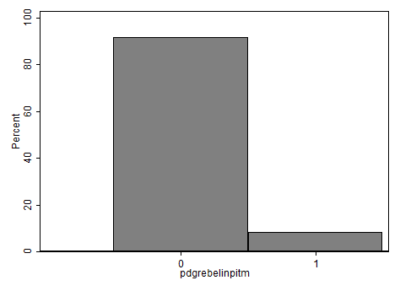
Rebel in the miner’s shaft
Among miners
Among pit managers
23%
8%

Slide 76
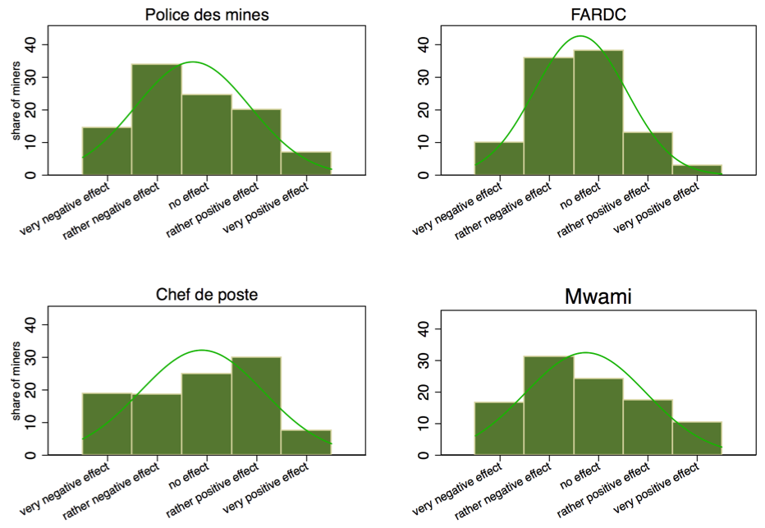

Slide 77
Taste to rebel 1, 2 = f(…)
Ambiguous incentives
stakes in mining, inequality
Frequency Banro, Interview quality
Distance between current and expected/aspired material welfare, Social class: PDG or miner, Frequency of Banro visits in past 4 weeks, Interview quality as reported by the enumerator

Slide 78
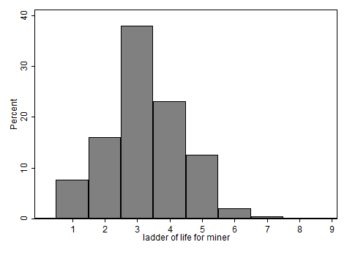
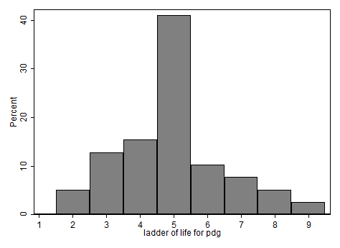
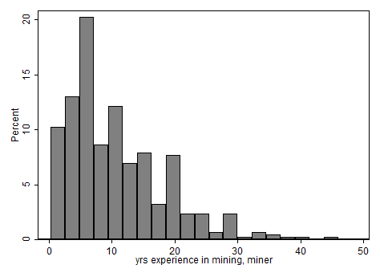
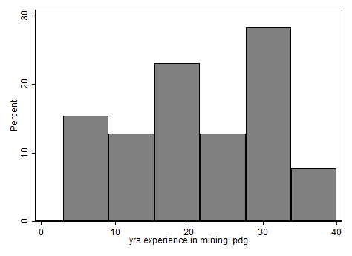
Miner vs. PDG

Slide 79
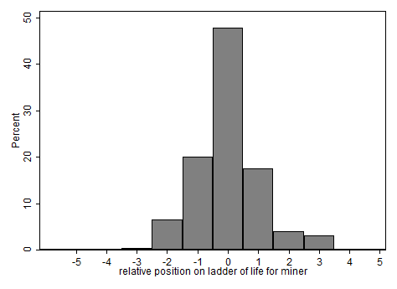
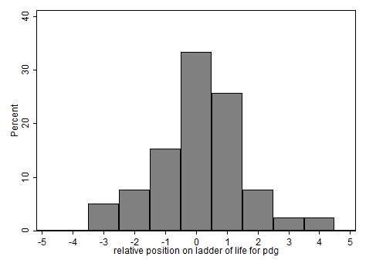
‘Relative deprivation’: Distance between own position and others’ position on ‘Ladder of life’

Slide 80
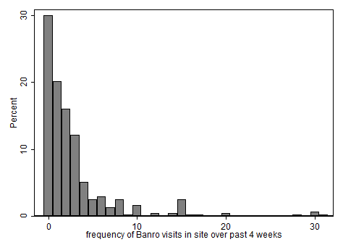
Frequency of on-site visit by Banro

Slide 81
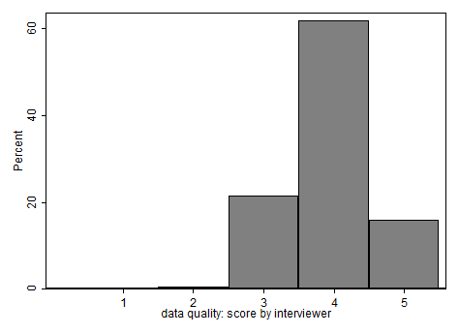
Interview quality
Very bad Bad Reasonable Good Very good

Slide 83
Six possible representations of the population of artisanal miners

Slide 84
How many of five representative miners (have) participate(d) in the activities of an armed group?

Slide 85
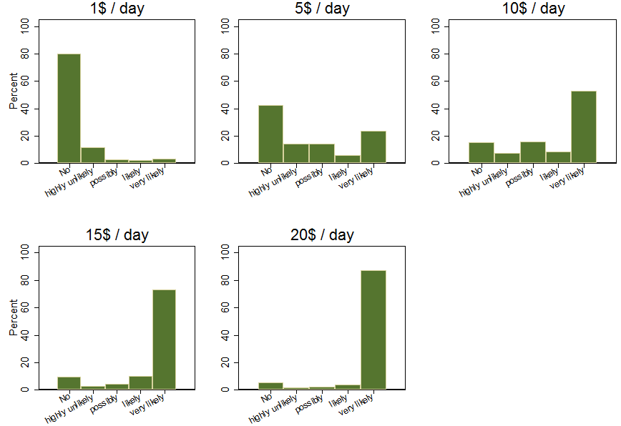
Reservation wage
76%
47%

