Slide 1
ARTISANAL MINING AND AGRICULTURE: analyzing the linkages Research project
Francine IRAGI MUKOTANYI
PhD candidate
IOB/University of Antwerp and CEGEMI/Université Catholique de Bukavu

Slide 2
Why am I undertaking the study?

Slide 3
Why am I undertaking the study?
Only a limited number of studies on the linkages between artisanal mining (AM) and agriculture
AM =
Complement [Maconachie and Binns (2007); Banchirigah and Hilson (2010)] or substitute [Hentschel et al. (2003); Banchirigah and Hilson (2010)] of agriculture
Important market for agricultural products [Maconachie and Binns (2007)]
Source of revenue for farmers [ Urama (2013) ]

Slide 4
Why am I undertaking the study?
2. Artisanal mining is threatened
Livelihood for millions of people
Formalization of the process
Some scholars think that this is not a viable alternative activity(Banchirigah and Hilson, 2010; Perks, 2011; Tschakert, 2009)
Dangerous, criminal and illegal activity
Artisanal mining
Two policy options
Promotion of alternative livelihoods, most of the time agriculture
Associated with long lasting conflict

Slide 5
What will I do?

Slide 6
What will I do?
Study the organization of agriculture in mining sites:
Analyze risks and constraints faced by the sector

Slide 7
What will I do?
Extend the study on the linkages between artisanal mining and agriculture by analyzing to what extent existing forward and backward linkages between these two sectors are “particular”
What would be the state of the agricultural activity in the absence of artisanal mining?

Slide 8
What will I do?
Analyze how artisanal miners perceive agriculture:
are they interested in being engaged in agriculture?
Under what circumstances and conditions they would choose agriculture as an alternative income activity should AM no longer be possible?

Slide 9
How will I do it?

Slide 10
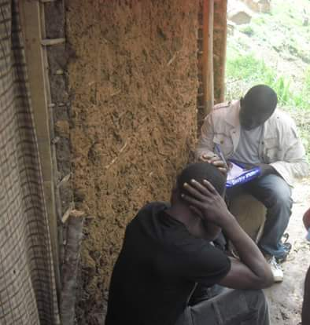
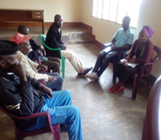
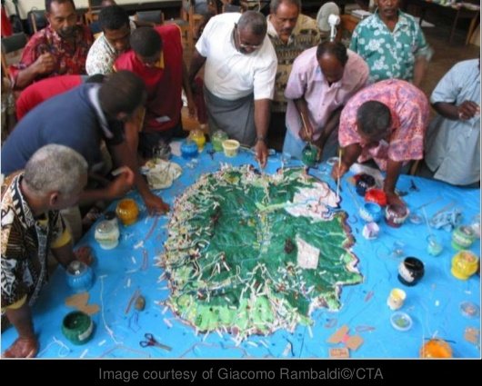
How will I do it?
Organization of agriculture in mining sites
Qualitative methods (individual interviews, focus groups and mapping) with all the stakeholders of the agricultural sector

Slide 11
How will I do?
Particular forward and backward linkages
Focus groups and individual interviews with farmers and artisanal miners to raise existing linkages between AM and agriculture
Sample of two group of farm households: control group and treated group
Propensity Score Matching Methods to get to the counterfactual

Slide 12
How will I do?
Perception miners have on agriculture as a potential alternative
Survey with artisanal miners
Descriptive statistics and regression analysis

Slide 13
Where am I ?

Slide 14
Where am I ?
A first pilot study will be conducted next month
Objective:
Understand the functioning of the agricultural sector in mining sites
Acquire all the preliminary and necessary information for my study

Slide 15
A first pilot study will be conducted next month
Questions
How are the production and marketing of agricultural products organized in mining sites?
What kind of constraints and risks are faced by its stakeholders and what strategies they put in place to face these risks and constraints?
What are the existing linkages between artisanal mining and agriculture?

Slide 16
A first pilot study will be conducted next month
Qualitative methods
Documentation, Focus group, mapping
Three kind of participants
Selection based on certain criteria such as the distance from the mining site, type of crop,
Four-part interview guide

Slide 17
Case study
Kalehe:
Agriculture and mining are dominant activities
The soil is fertile and agriculture is flourishing

Slide 18
THANK YOU FOR YOUR ATTENTION
QUESTIONS AND COMMENTS ARE WELCOME

