Slide 1
Empowerment at the City of Joy? A study of a leadership program for survivors of sexual violence in Eastern DRC
Susanne Alldén, Christine Amisi, Rosalie Biaba, Aline Cikara, Ragnhild Nordås, Gudrun Østby,
Esther Namegabe & John Quattrochi
“Transition and local development in eastern DRC”, Bukavu, 8-10 December 2016

Slide 2
Background
Widespread sexual violence in the eastern DRC
survivors face marginalization and social exclusion
Knowledge gap:
Whether and how support programs help to empower survivors of sexual violence
Collaborative project:
Peace Research Institute Oslo (PRIO) & International Centre for Advanced Research and Training (ICART), Bukavu

Slide 3
Research questions
1) During program:
How are perceptions of possibilities of female participation and empowerment changed over the course of the program?
2) After program:
What determines whether and to what extent the CoJ graduates take on community leadership roles after they leave the program,
…and what obstacles/opportunities do they face in particular when asserting their rights to representation?

Slide 4
Female empowerment defined
Female empowerment…
…refers to autonomy and self-determination in women, enabling them to represent their interests in a responsible and self-determined way, and acting on their own authority.
…involves knowing and being willing to exercise one’s rights, and enables overcoming a sense of powerlessness and lack of influence, and to recognize and eventually to use one’s resources and opportunities.
…can also mean the power to decide for oneself.

Slide 5
City of Joy (CoJ)
Established in 2011under slogan of “transferring pain into power”
Locally initiated and run, international funding
Support program for young vulnerable women, aged18-29
6-month program
Serving 90 survivors of gender violence at a time
The program has graduated 759 women to date

Slide 6
Admission criteria
female
aged 18-29,
have been traumatized by the tragic event (based on the gender)
have been taken care of:
have a medical certificate that testifies to her situation,
have been subjected to psychotherapy (she must be referred by a grassroots association or organization which works in the field of GBV
be willing to spend six full months out of her home environment,
be ready to live as a single woman/girl with no child, during stay at CoJ
adhere to the principles established by V-Day/ City of Joy
be ready for change after her healing and training at City of Joy,
have abilities to bring change to her home place.
prepared for her community reinsertion upon completion of her stay and training at CoJ

Slide 7
City of Joy’s 10 tenets
(1) Tell the truth,
(2) Stop waiting to be rescued. Take initiative,
(3) Know your rights,
(4) Raise your voice,
(5) Share what you have learned,
(6) Give what you want the most,
(7) Feel free and tell the truth about what you've been through,
(8) Use it to fuel a revolution,
(9) Practice kindness, and
(10) Treat the life of your sister as though it were your own

Slide 8
Empirical strategy
Quantitative – RQ1
Entry- and exit surveys of 2 CoJ cohorts (175 women)
Qualitative –RQ2
Focus Group discussions
6 groups with10 participants
50 individual interviews:
30 women interviewed once, after graduation
20 interviewed twice: after 3 and 8 months
Notes:
All data collection done by ICART team

Slide 9
Survey
168 questions
Respondents:
2 cohorts covered (2015, 2016)-- 179 women surveyed
The age-span of respondents is 18–31 years (average 20.4 years).
Most from South Kivu (82%)
77.5% are single,
50.6% have some secondary school,
Number of children ranges between 0 and 3

Slide 10
Questions about female leadership (survey)
Do you strongly agree, agree, disagree or strongly disagree with the following statements?
“A woman can become a village leader”
“A woman can have another position of local power”
“A woman could become president of the DRC”
“A woman can be the boss of men in business”
“Men should be community leaders”

Slide 11
Female leadership

Slide 12
Right to organize and time trends

Slide 13
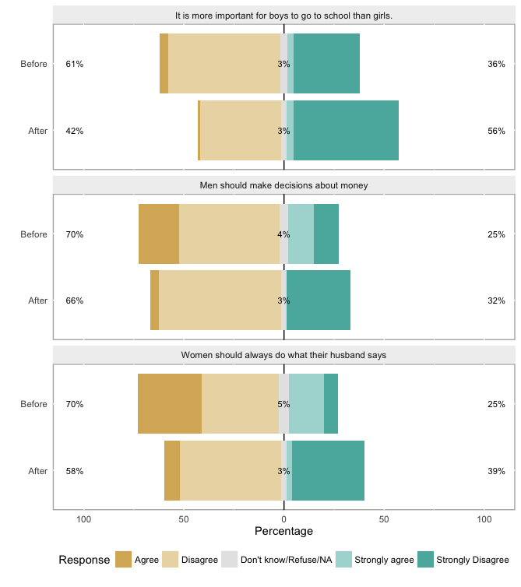
Gender roles

Slide 14
Table 1. Regression of opinion shift – can a woman be the boss of men in business?
 | DV: A woman can be the boss of men in business (value at exit-value at entry)
 | Estimate | Std error | p-value
Intercept | -0.40 | 0.55 | 0.468
Some primary school | -0.21 | 0.42 | 0.617
Completed primary school | 0.13 | 0.48 | 0.782
Some secondary school | 0.26 | 0.39 | 0.512
Completed secondary school | 0.72 | 0.48 | 0.133
Aluminum roof | 0.01 | 0.20 | 0.943
Single | -0.54 | 0.46 | 0.235
Separated/Widowed/Divorced | -0.37 | 0.51 | 0.472
N=179. Reference categories: education=”none”, marital status= “married”, roof= “straw”

Slide 15
Table 2. Regression of opinion shift – Should men decide about money?
 | DV: Men should decide about money
 | Estimate | Std error | p-value
Intercept | 1.61 | 0.58 | 0.006
Some primary school | -0.03 | 0.44 | 0.937
Completed primary school | -0.30 | 0.50 | 0.546
Some secondary school | -0.26 | 0.41 | 0.532
Completed secondary school | -0.98 | 0.50 | 0.051
Aluminum roof | 0.31 | 0.21 | 0.142
Single | -0.60 | 0.48 | 0.214
Separated/Widowed/Divorced | -1.03 | 0.54 | 0.058
N=179. Reference categories: education=”none”, marital status= “married”, roof= “straw”

Slide 16
Quotes from qualitative interviews
“A man was beating his wife, I came forth and said you have no right to do that, and the woman has right to live in freedom, he wanted to chase his wife and told him that his wife shall not go anywhere because they have had already children, they have a piece of land that they bought together and built, they used to rent a house before, so this was not the time to chase her, he also makes mistakes, why not his wife? she is not a cow to be beaten , I intervened a lot to prove that this was not life , if not, both should leave the house and let the house belong to the children, the man asked me where I have learnt all of these things, I told him that these are things he is supposed to know regardless of where I learnt them, that is why in our community men say that I have many things in my mind and that people should be careful with me”.
Interview with CoJ Graduate, Kamanyola, 2016/04/13

Slide 17
If I see a girl who is in the same situation as I was, I talk to her, I talk to other mothers....They start asking me a lot of questions, and when they see the change I've made, they say it's worth listening to me.
Interview with CoJ Graduate, Goma, 2016/03/17

Slide 18
Preliminary conclusions and future directions
Significant changes in the opinions and attitudes towards female empowerment, gender equality, and women leadership over the course of the six-month program
Increased knowledge about rights
Attitudes shift to more gender-equal norms
Participants become more aware of the challenges/ problems for female empowerment
Could have developed a more cautious view
Future research
Collection of more qualitative data on challenges and successes
Follow-up project in 2017 (funded by Folke Bernadotte Academy, Sweden)
Systematic of the long-term effects of CoJ for former graduates

