Slide 1
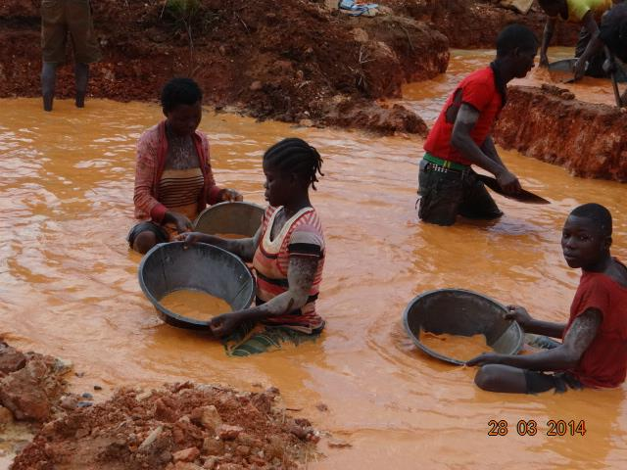
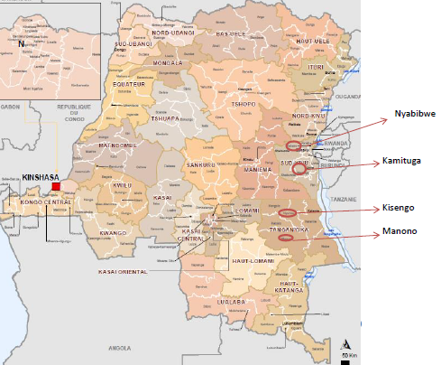
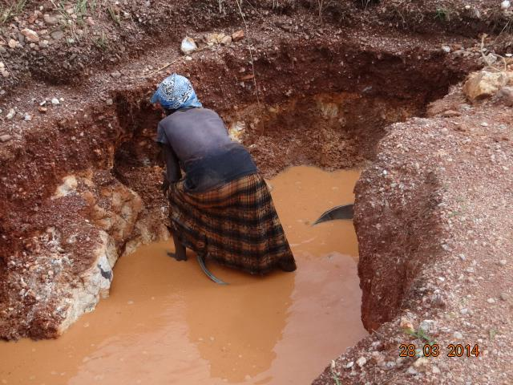
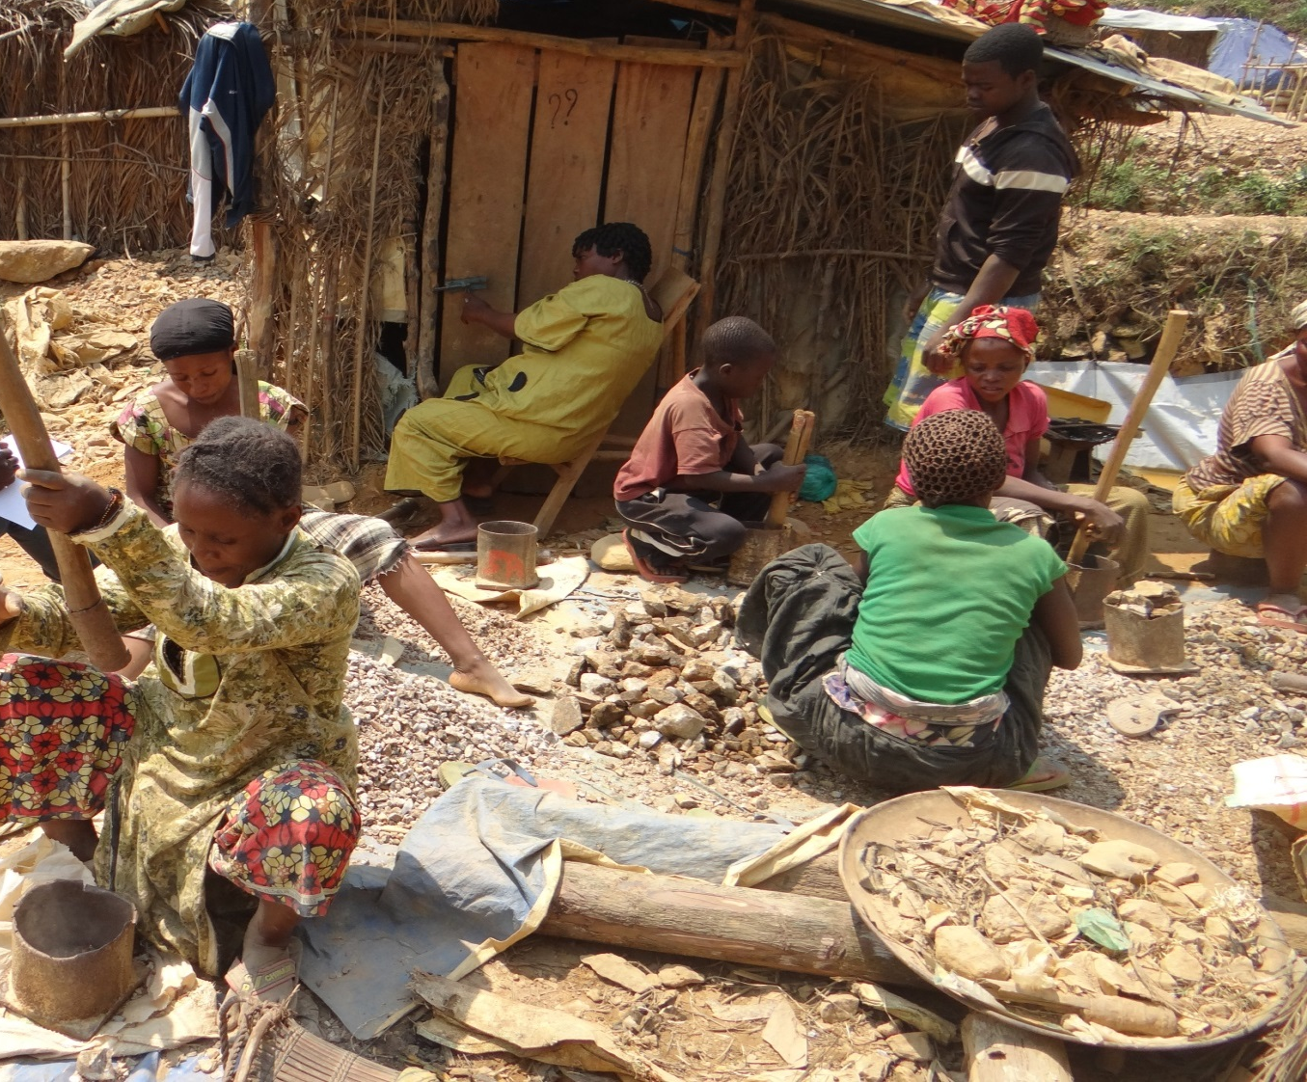
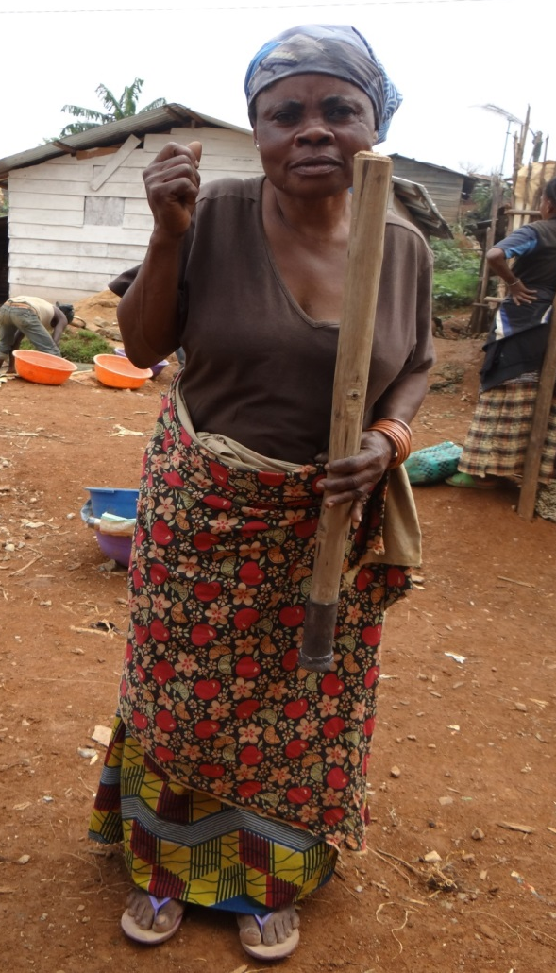
Barriers and opportunities: Women’s livelihoods and diverse responses to transformations in artisanal mining in eastern DRC
Marie rose Bashwira Nyenyezi, PHD Candidate, Wageningen University, The Netherlands
Research question
Findings
Main question: How do differentially positioned women navigate and negotiate the transformations of artisanal mining in the context of mining reforms in eastern DRC?
sub-questions:
1.How has the reforms process and the discourse around it affected women’s access to mining activities?
2.Why are women deciding to move and settle in artisanal mining areas? What challenges do they face after arriving in the mining areas, and how do they cope with life there?
3.What kind of activities are women involved in at the mining sites, and what different combinations of livelihood strategies differentiate these women?
4.How has the formalisation process influenced the position of women and power structures at the local level?
1. Access to resources
- The dominance of the conflict mineral discourse has consequences on women participation in the mining. First, a side effect of protective legislation is the exclusion of pregnant women. Second, there has been a lack of recognition of women’s roles in artisanal mining.
- The requirement to hold an ID card to access a step in the value chain has very severe consequences for poor women.
- The gender mainstreaming discourse coexists with the conflict-related discourse and the cultural (local) gender ideology, and this creates confusion regarding how to implement the reforms and barrier to women’s inclusion in the mineral sector. However, this also gives women room for manoeuvre to negotiate they participation
Methods
2. Diversity
- Women have complex motives for migrating and for settling in mining centres.
- Women have different socioeconomic roles in the mining centres: They are involved in multiple activities related to mining exploitation either directly (digging, washing, transporting, owning pits, trading) or indirectly (agriculture, restoration, business, prostitution).
- Some women at the mining sites have a very marginal existence (heavy and exploitative jobs, heavy and uneven work schedules, low income, little time for family, etc.), whereas others are more comfortable and have more options and strategic opportunities.
- Women in mining centres are most clearly differentiated by how they combine livelihoods depending on their social and economic assets, access to institutional structures, and choice of the coping strategies.
3. Power relations and change in the labour regime
- The reform initiatives have allowed the creation of new forms of power by widening the gap between formal and customary (informal) institutions and thus inducing differentiation between these institutions..
- The formalisation of artisanal mining has created sub-categories of actors and new forms of power relations, discriminating against those who were already marginalised by the mining structure. The phenomenon of the “sous-couvert” is one example.
(Documentation, Focus group , Semi- structured interviews, Snowball sampling).
Provinces: South-Kivu and Tanganika
PLace: Kamituga (Mwenga), Nyabibwe, Kisengo (Nyunzu) and Manono.
Participants: state officers at provincial and local level; local Ngo focusing on women, men and women miners, people living in the mining community
Figure 1. Provinces in the DRC.
ISDR – BUKAVU
B.P. 2849 BUKAVU

