Slide 1
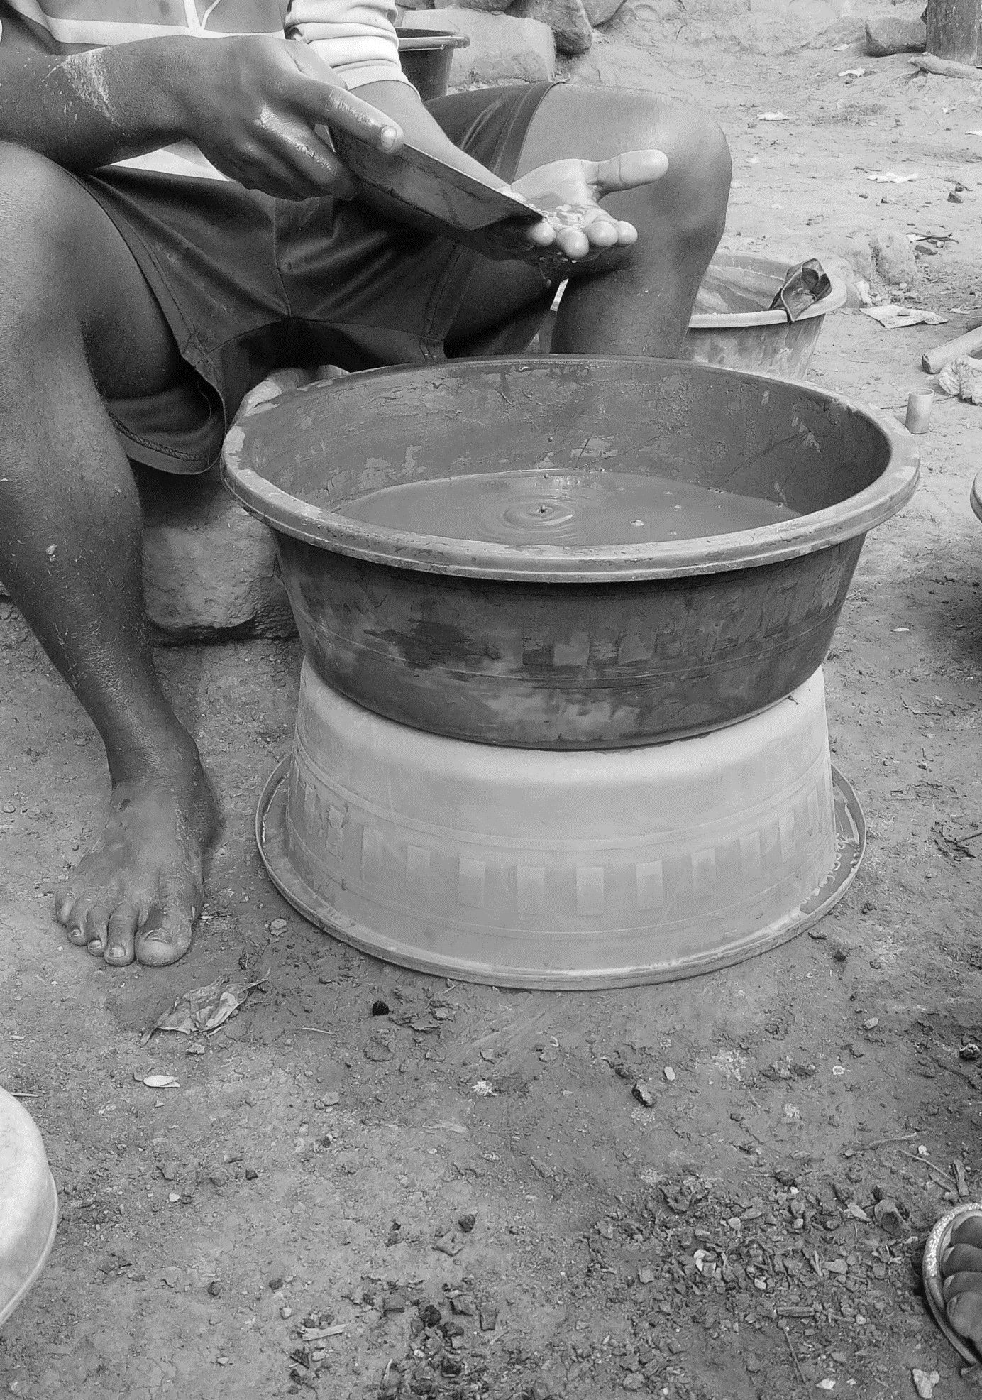
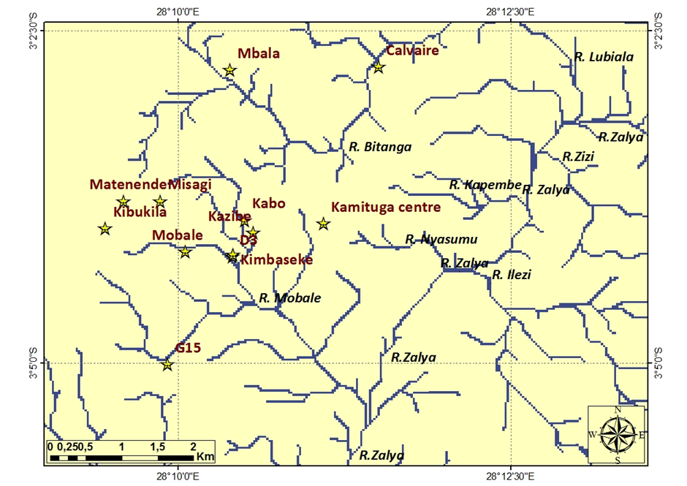

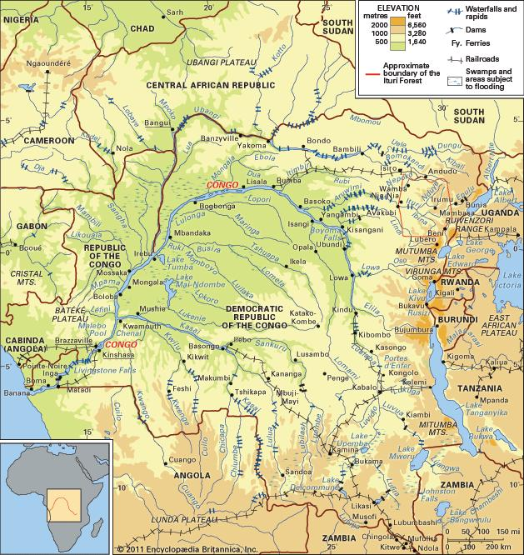
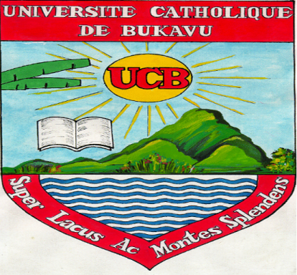
Mercury in gold mining: diagnosis and perception study in Kamituga, DRCongo
Bossissi Nkuba*, Lieven Bervoets & Sara Geenen
1. Introduction
Overlap between natural ecosystems and mining reserves in DRC.
deforestation, river siltation, soil erosion, poaching and chemical pollution by acids, Cu, Pb, As, HCN, Hg
But these effects are not well studied in DRC, especially the less visible effect like mercury pollution from gold mining.
3. Results
3.1. Mercury use in gold mining
Four techniques are used for gold extraction. In all cases density separation is used first and when this can no longer extract gold from the ore, mercury is used.
Mercury is used in or near peoples houses (background picture).
Three rivers (Nyasumu,
Kapemba and Bitanga) are
exposed to mercury pollution
from gold mining (see map →
: red zone = mercury use area).
3.2. Governance
The law forbids using mercury (Code Minier; Reglement minier).
Governmental agencies in charge of enforcement are ineffective because of several challenges they face (prioritization of taxation above environment protection, lack of well-educated personnel, limited motivation due to salary un-payment).
Civil society, Media, NGOs and stakeholders don’t organize any sensitization against mercury use.
3.3. Local perceptions
Miners, stakeholders and the
population do not have
information on the effects of
mercury on health and the
environment (see graph →).
Study aims:
a) Identifying how, how much and where mercury is used
b) Analyzing actions, interactions and potentials of mercury use governance stakeholders
c) Assessing the knowledge of miners, local population and other stakeholders regarding health and environmental threat from mercury in gold mining
2. Methodology
The study was conducted in Kamituga ( on the map ↓ )
+ Focus group discussions were organized with miners and other stakeholders
+ Personal interviews with some
stakeholders.
+ Household survey with a 216
sample size
+ Field observations and literature
review.
+ Participatory mapping combined
with Digital Elevation Model to determine which rivers are threatened by mercury
4. Conclusion
Although mercury use is strictly regulated by the mining code, it is not sufficient because of two main reasons:
public services, mandated to protect the environment, face financial, material, technical and human constraints to do so,
lack of specific information on the potential effects of mercury pollution.
Neither the key stakeholders in the mining sector, nor the miners or the general population, have access to appropriate information.
Mercury pollution risk is very real, because gold is mercury-treated in or near miners’ houses, in the different neighbourhoods, exposing three rivers of which catchments overlap with areas where mercury is used.
Aknowledgement to the CEGEMI/UCB and the CREAC for funding this study; to Daniel Muhindo, Cito Miderho, Franck Zahinda and the other members of the survey team; and to the SAESSCAM and COKa leaders for their assistance during our field work.
*bossissi.nkuba@ucbukavu.ac.cd
CEGEMI
Centre d’Expertise en Gestion des Mines - Expertise Center on Mining Governance
Université Catholique de Bukavu

